Slide 1


Efficient and Effective Joint Optimization of Multimodal Item Representations for Recommendation
Junchen Fu
PhD Candidate
University of Glasgow
June 29, 2026
Personal Homepage:
https://junchen-fu.github.io/
Main Supervisor:
Prof. Joemon M. Jose
Notes:
I will frame the whole presentation from a joint optimization perspective. The core question is how multimodal item representations can be optimized together with recommendation objectives instead of being used as fixed, pre-extracted features.
The talk has two representation branches. IISAN, IISAN-Versa, and CROSSAN focus on continuous representations, where items are represented as dense text/image/multimodal embeddings. DIGER focuses on discrete representations, where items are represented as semantic ID tokens for generative recommendation.
The main message is that foundation models provide strong multimodal priors, but recommendation performance depends on how efficiently and stably we align those representations with user preference signals.

Slide 2
Table of Contents
Background
Joint Optimization of Continuous Representation
Joint Optimization of Discrete Representation
Conclusions and Key Takeaways
Notes:
This agenda follows the joint optimization logic. I will first motivate why fixed multimodal feature extraction is limited for recommendation.
Then I will discuss joint optimization for continuous representations: how to adapt dense multimodal encoders efficiently through IISAN, then make the design compatible with asymmetric LLM/vision encoders through IISAN-Versa, and finally scale it to more modalities through CROSSAN.
After that I will switch to discrete representations. The key difference is that the item representation becomes a semantic ID token sequence, so I first introduce the TIGER generative retrieval paradigm and then explain how DIGER enables stable joint optimization of semantic IDs and the recommender.

Slide 3
Presented Papers
Continuous representations
1. IISAN: Efficiently adapting multimodal representation for sequential recommendation with decoupled PEFT. SIGIR 2024.
2. IISAN-Versa: Efficient and effective adaptation of multimodal foundation models in sequential recommendation. TKDE 2025.
3. CROSSAN: Efficient adaptation of multiple multimodal foundation models for sequential recommendation. arXiv 2025.
Discrete representations
4. DIGER: Differentiable Semantic ID for Generative Recommendation. SIGIR 2026.
Notes:
The presented papers are grouped by representation type rather than by chronology. The first group is continuous representation learning: IISAN, IISAN-Versa, and CROSSAN all adapt dense multimodal representations for recommendation.
IISAN establishes the efficiency mechanism through decoupled PEFT and caching. IISAN-Versa extends the idea to larger and asymmetric foundation encoders. CROSSAN extends the same direction to multiple modalities and multiple foundation models.
The second group is discrete representation learning. TIGER is used here as the reference paradigm: it introduces semantic IDs for generative retrieval. DIGER then addresses the missing joint optimization step by making semantic IDs differentiable and stable.

Slide 4
Table of Contents
Background
Joint Optimization of Continuous Representation
Joint Optimization of Discrete Representation
Conclusions and Key Takeaways
Notes:
This agenda follows the joint optimization logic. I will first motivate why fixed multimodal feature extraction is limited for recommendation.
Then I will discuss joint optimization for continuous representations: how to adapt dense multimodal encoders efficiently through IISAN, then make the design compatible with asymmetric LLM/vision encoders through IISAN-Versa, and finally scale it to more modalities through CROSSAN.
After that I will switch to discrete representations. The key difference is that the item representation becomes a semantic ID token sequence, so I first introduce the TIGER generative retrieval paradigm and then explain how DIGER enables stable joint optimization of semantic IDs and the recommender.

Slide 5
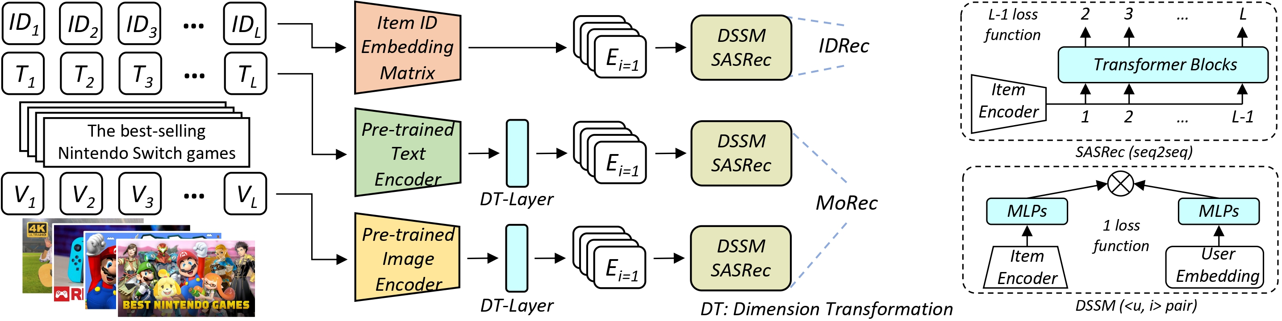
Background
Multimodal sequential recommendation tasks
[1] Zheng Yuan, Fajie Yuan, Yu Song, Youhua Li, Junchen Fu, Fei Yang, Yunzhu Pan, and Yongxin Ni. "Where to go next for recommender systems? id-vs. modality-based recommender models revisited." SIGIR’23.
Notes:
This slide gives the background of multimodal sequential recommendation. In these tasks, each item can be described by user interactions as well as multimodal content such as text, images, video, or audio.
Traditional pipelines often encode the content first and then feed the extracted features into a recommender. From a joint optimization view, the limitation is that the multimodal encoder does not directly receive recommendation feedback.
This motivates the central theme of the talk: item representations should not only preserve content semantics, but also align with user preference and next-item prediction.

Slide 6
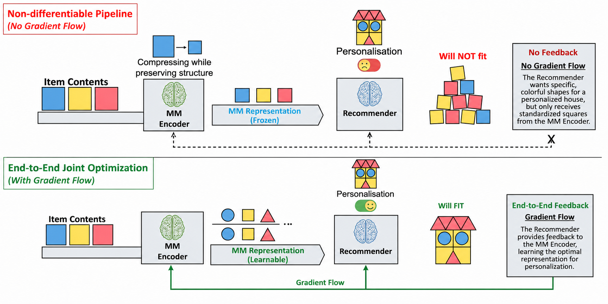
Background
Notes:
I use this metaphor to explain the two-stage limitation. The multimodal encoder is like a brickmaker: it produces standardized bricks that preserve general content structure.
The recommender is like a builder who wants to construct a personalized house. If there is no feedback from the builder to the brickmaker, the bricks may be semantically meaningful but not optimized for the exact personalized recommendation objective.
This is the intuitive motivation for joint optimization: recommendation signals should be able to influence how item representations are formed.

Slide 7
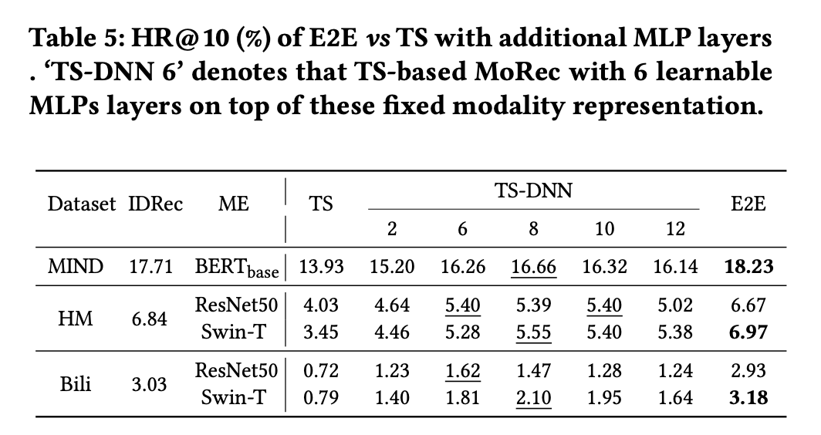
Background
TS (Two-stage) vs. E2E (End-to-end)
[1] Zheng Yuan, Fajie Yuan, Yu Song, Youhua Li, Junchen Fu, Fei Yang, Yunzhu Pan, and Yongxin Ni. "Where to go next for recommender systems? id-vs. modality-based recommender models revisited." SIGIR’23.
Notes:
This empirical comparison further motivates the move from two-stage feature extraction to end-to-end optimization. The two-stage setting remains weaker even when additional MLP layers are added on top of frozen features.
The lesson is that simply adding a small prediction head is not enough. The representation itself must be adapted toward recommendation signals.
This sets up the first technical branch: joint optimization for continuous multimodal representations.

Slide 8
Table of Contents
Background
Joint Optimization for Continuous Representation
Joint Optimization for Discrete Representation
Conclusions and Keytakeaways
Notes:
Now I move to the continuous representation branch. In this part, the item representation is still a dense vector from text, image, or multimodal foundation encoders.
The challenge is that joint optimization with full fine-tuning can be too expensive. Therefore the question becomes: how do we let recommendation signals shape dense representations while controlling memory, training time, and model complexity?
The sequence of methods is IISAN for efficiency, IISAN-Versa for asymmetric large encoders, and CROSSAN for modality breadth.

Slide 9
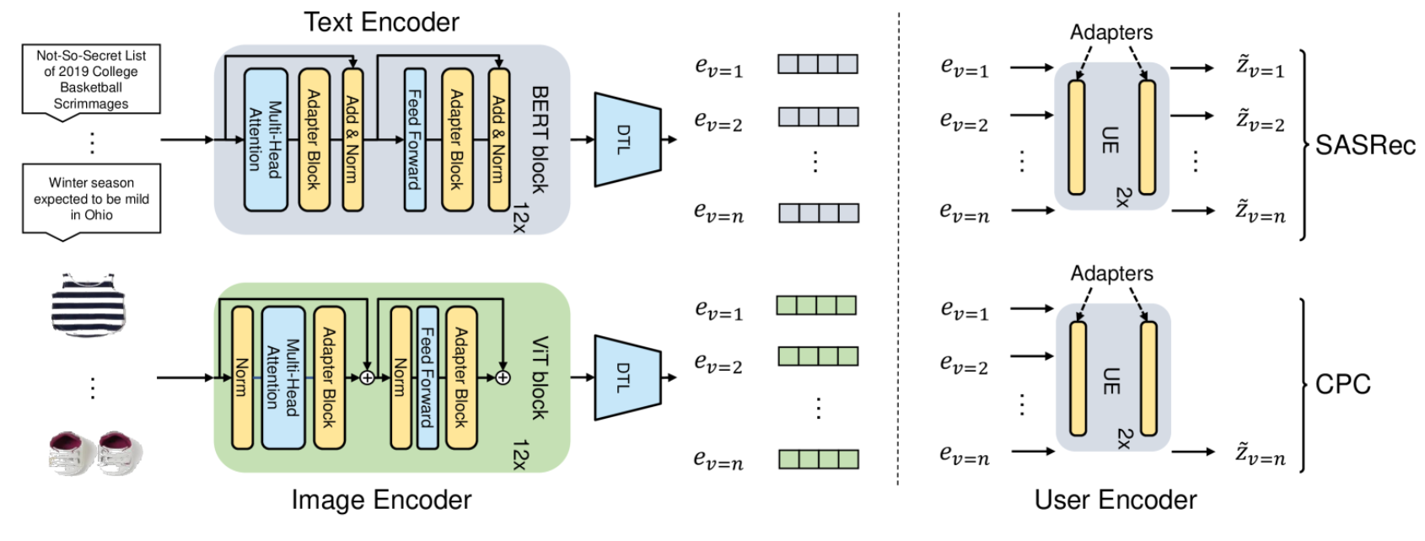
Joint Optimization for Continuous Representation
Adapter4Rec
[1] Fu, Junchen, et al. "Exploring adapter-based transfer learning for recommender systems: Empirical studies and practical insights." WSDM’24.
Notes:
Adapter4Rec is a useful preliminary step for this story. It studies whether adapter-based PEFT can replace full fine-tuning for recommendation-oriented adaptation.
The main takeaway is that PEFT can achieve competitive performance with far fewer trainable parameters, which makes end-to-end adaptation more realistic.
However, standard embedded PEFT still places the trainable modules inside the transformer computation graph. That means memory and training-time costs are not fully solved, which motivates IISAN.

Slide 10
Joint Optimization for Continuous Representation
Traditional adaptation approaches typically adopt full fine-tuning for pre-trained modality encoders, which is costly in terms of GPU memory and training time.
Adapter4Rec-style PEFT reduces trainable parameters through adapters or LoRA, but these modules are still embedded inside the backbone computation graph.
This motivates decoupled PEFT for efficient joint optimization of continuous item representations.
Fu, Junchen, et al. "IISAN: Efficiently adapting multimodal representation for sequential recommendation with decoupled PEFT." SIGIR’24.
Notes:
This slide introduces the efficiency problem more directly. Full fine-tuning updates the whole modality encoder, so it is expensive in GPU memory and training time.
Embedded PEFT methods such as adapters or LoRA reduce the number of trainable parameters, but they still require forward and backward propagation through the backbone because the trainable modules are inside the model.
From the joint optimization perspective, the goal is to keep the benefit of recommendation-specific adaptation while avoiding repeated optimization of the entire foundation encoder. This leads to decoupled PEFT in IISAN.

Slide 11
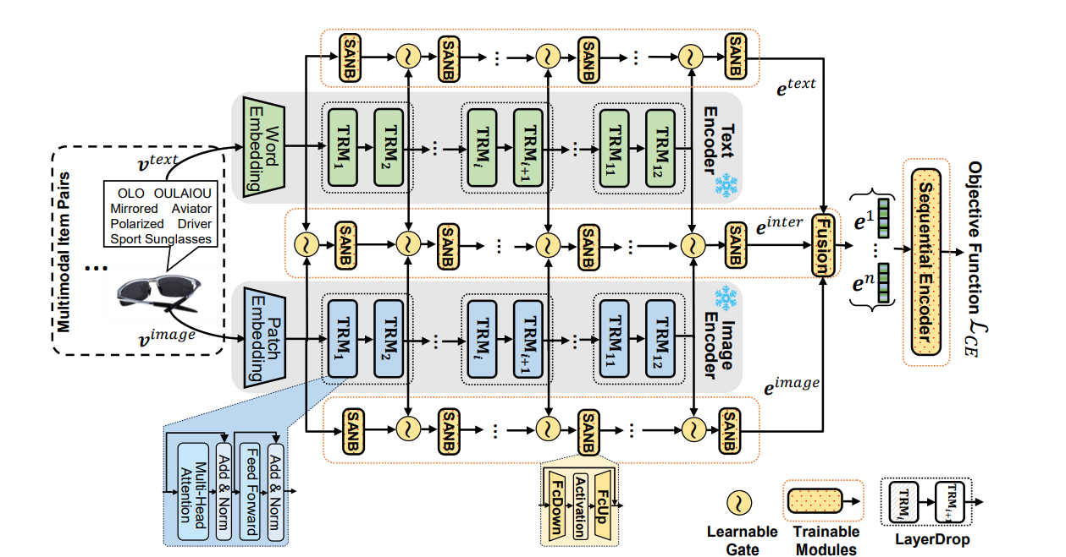
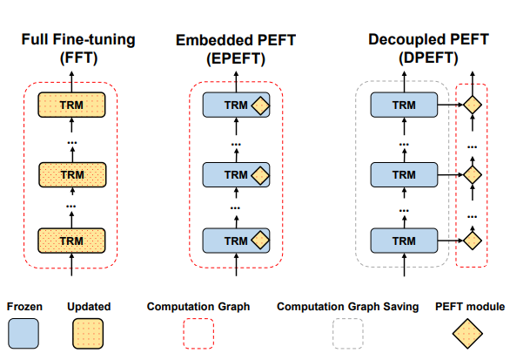
Joint Optimization for Continuous Representation
IISAN addresses this problem with a decoupled paradigm and intra-/inter-modal side adapter towers.
Fu, Junchen, et al. "IISAN: Efficiently adapting multimodal representation for sequential recommendation with decoupled PEFT." SIGIR’24.
Notes:
IISAN addresses this problem by separating the frozen pretrained encoders from trainable side adapter towers.
The architecture performs intra-modal adaptation within each modality and inter-modal adaptation across modalities. The dense item representations are still optimized for recommendation, but the expensive backbone is not directly updated.
This is the first key idea in the continuous branch: joint optimization does not have to mean full fine-tuning. We can optimize recommendation-specific side networks around frozen foundation representations.

Slide 12
Joint Optimization for Continuous Representation
DPEFT enables hidden states to be cached for efficient joint optimization.
Notes:
The caching mechanism is the main efficiency advantage of decoupled PEFT. In embedded PEFT, adapter updates change hidden states in later transformer blocks, so the backbone computation must be repeated during training.
In decoupled PEFT, the backbone is frozen and the side modules do not change its hidden states. Therefore those hidden states can be cached and reused.
This turns the efficiency problem from an architectural issue into a caching-friendly computation graph, which is crucial for applying large multimodal encoders in recommendation.

Slide 13
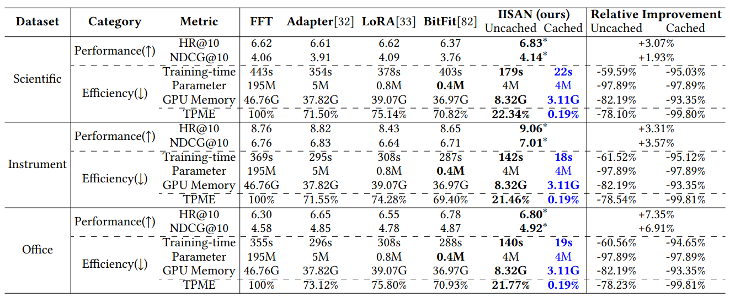
Joint Optimization for Continuous Representation
IISAN delivers superior performance while maintaining exceptional efficiency.
Notes:
The experimental results show that IISAN maintains strong recommendation performance while improving efficiency in training time, memory, and trainable parameters.
The important point is that efficiency should not only be measured by parameter count. For recommendation systems, caching, memory footprint, and repeated item encoding are equally important.
Therefore IISAN demonstrates that joint optimization of continuous multimodal representations can be both effective and practical.

Slide 14
Joint Optimization for Continuous Representation
Although IISAN demonstrates state-of-the-art efficiency and effectiveness in adapting multimodal foundation models (MFMs) for recommendation tasks, it still faces two major limitations (Depth and Breadth) that restrict its broader applicability:
Depth Limitation: It relies on the assumption of symmetrical multimodal encoders, which does not hold in practice, as large language models (LLMs) are typically much deeper than vision encoders.
Breadth Limitation: It supports only two modalities, overlooking the fact that real-world recommendation scenarios often involve multiple modalities beyond just text and vision.
Notes:
After IISAN, the next motivation is versatility. IISAN shows how to make adaptation efficient, but real multimodal foundation encoders are often structurally different.
For example, text encoders or LLMs can be much deeper than visual encoders. If we assume one-to-one layer matching, the adaptation architecture becomes fragile.
This motivates IISAN-Versa: we need a joint optimization framework for continuous representations that can handle heterogeneous encoder depth and scale.

Slide 15
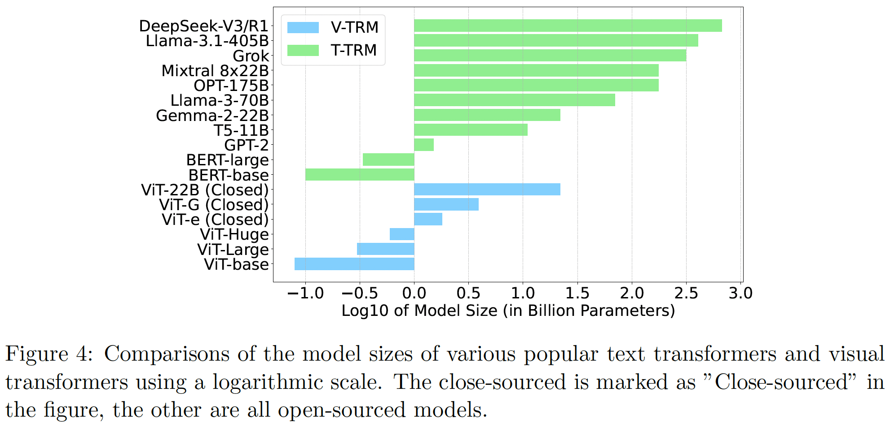
Joint Optimization for Continuous Representation
Text Transformers are typically much deeper than Visual Transformers, leading to structural asymmetry during adaptation.
Notes:
This slide illustrates the structural asymmetry problem. Text transformers are usually deeper than visual transformers, and the layer correspondence between modalities is not obvious.
If we force direct alignment between every layer, the side adapter design becomes inefficient or mismatched.
So the motivation for IISAN-Versa is to adapt continuous multimodal representations across asymmetric foundation encoders without giving up the efficiency benefits of IISAN.

Slide 16
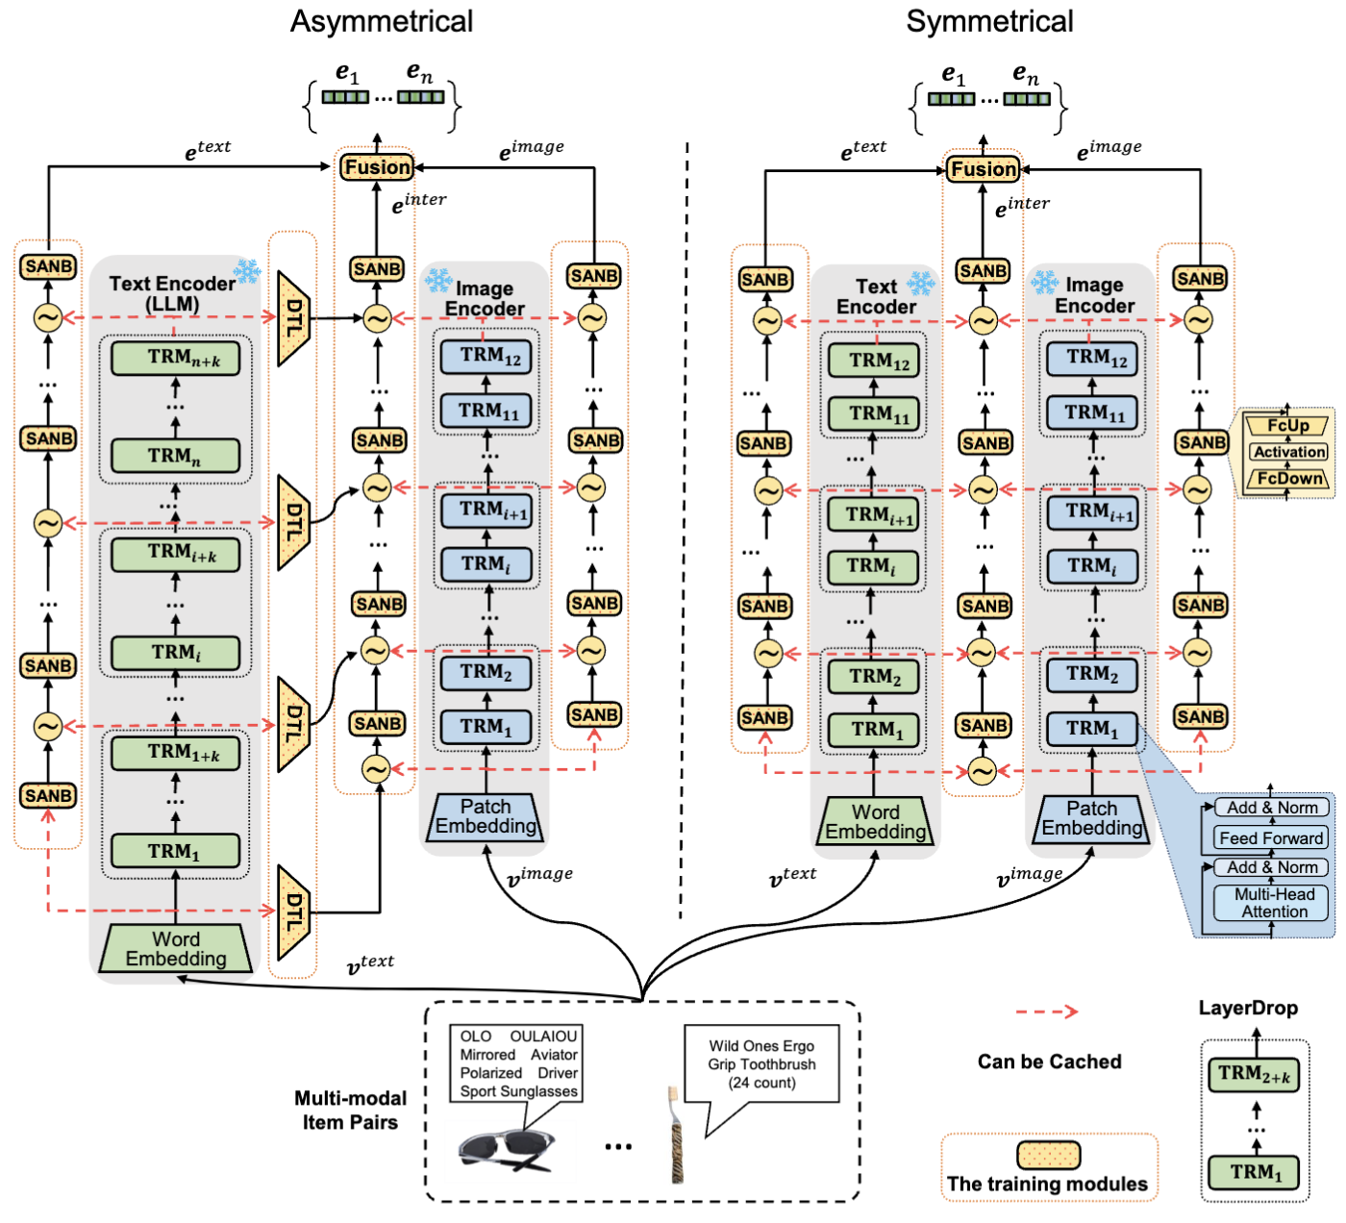
Joint Optimization for Continuous Representation
IISAN-Versa handles asymmetric structures using simple dimension transformation layers and group layer dropping.
Fu, Junchen, et al. "Efficient and effective adaptation of multimodal foundation models in sequential recommendation.” IEEE TKDE’25
Notes:
IISAN-Versa handles this asymmetry with simple but effective mechanisms: dimension transformation layers and group layer dropping.
Instead of forcing exact layer-to-layer correspondence, it aligns compatible groups of layers and transforms their dimensions when needed.
In the continuous representation story, IISAN-Versa extends joint optimization from efficient adaptation to versatile adaptation, especially when larger LLM-style text encoders are used together with visual encoders.

Slide 17
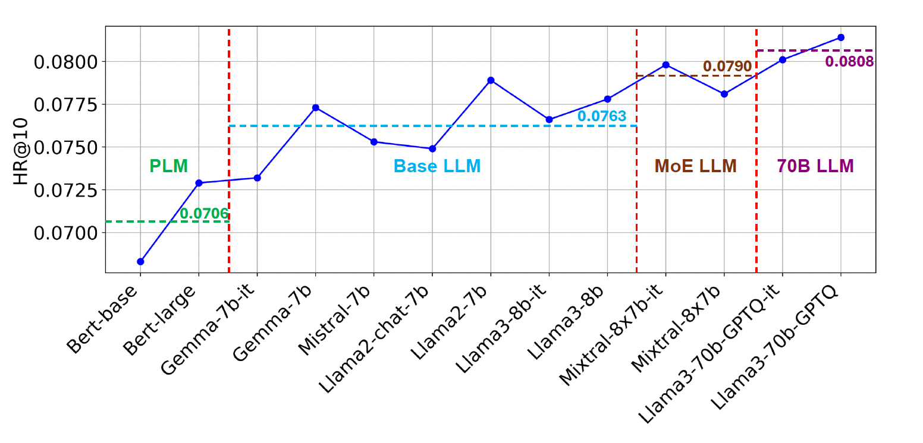
Joint Optimization for Continuous Representation
IISAN-Versa can incorporate larger LLMs as encoders and demonstrates a scaling effect as the model size increases.
Notes:
This result connects recommendation to the broader scaling behavior of foundation models. Larger language models can provide stronger text-based item representations.
However, scaling alone is not enough. Larger encoders also increase computation, storage, and deployment cost.
The value of IISAN-Versa is that it makes this scaling effect usable by preserving efficient adaptation and caching while allowing larger encoders to participate in continuous representation learning.

Slide 18
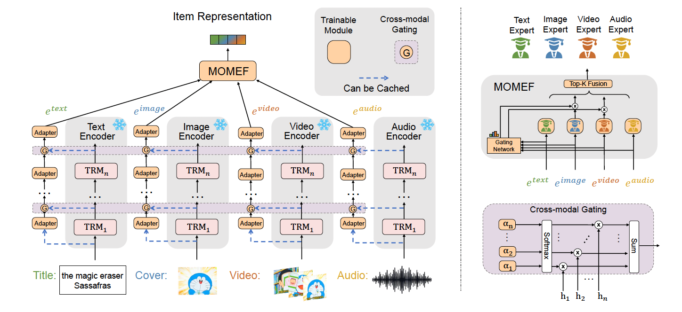
Joint Optimization for Continuous Representation
CROSSAN extends joint optimization to more modalities.
Fu, Junchen, et al. "CROSSAN: Towards efficient and effective adaptation of multiple multimodal foundation models for sequential recommendation." arXiv’25.
Notes:
CROSSAN addresses the breadth side of the continuous representation problem. Real items may contain not only text and images, but also video, audio, and other modalities.
The goal is to jointly adapt multiple multimodal foundation models and fuse their representations in a controlled way.
So while IISAN focuses on efficiency and IISAN-Versa focuses on structural asymmetry, CROSSAN asks how joint optimization can scale to more modalities.

Slide 19
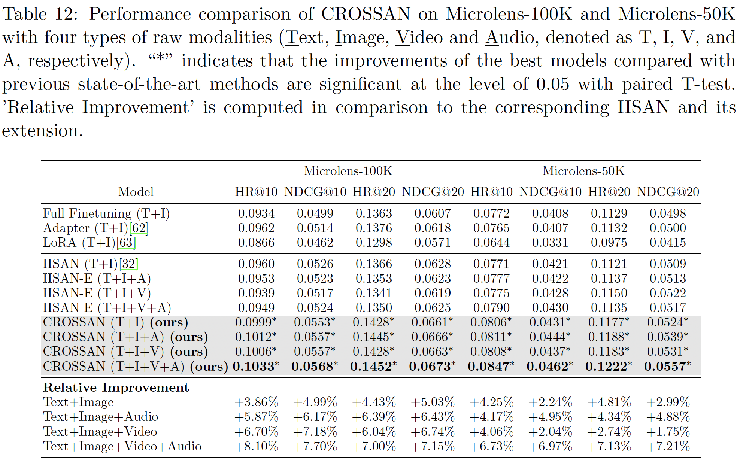
Joint Optimization for Continuous Representation
More modalities
Better Performance
Notes:
The results show that more modalities can improve performance when the fusion and adaptation are handled properly.
The key point is not simply to concatenate every available modality. CROSSAN uses cross-modal gating and modality-aware adaptation so that useful signals are selected and aligned.
This completes the continuous representation branch: efficient adaptation, versatile adaptation across asymmetric encoders, and broader adaptation across multiple modalities.

Slide 20
Conclusions and Key Takeaways
Key Points: Continuous Representations
1. The field is moving from fixed feature extraction to end-to-end foundation-model adaptation.
2. Full fine-tuning can improve performance, but it is expensive in memory and training time.
3. IISAN makes continuous representation learning efficient through decoupled side adapters and caching.
4. IISAN-Versa and CROSSAN address depth asymmetry and modality breadth.
Notes:
This slide summarizes the continuous representation part. The overall movement is from fixed feature extraction to end-to-end foundation-model adaptation.
IISAN contributes the efficiency foundation through decoupled side adapters and caching. IISAN-Versa extends the framework to asymmetric and larger encoders. CROSSAN extends the framework to multiple modalities.
All three methods share the same joint optimization perspective: dense multimodal item representations should be adapted toward the recommendation objective while remaining computationally practical.

Slide 21
Table of Contents
Background
Joint Optimization for Continuous Representation
Joint Optimization for Discrete Representation
Conclusions and Key Takeaways
Notes:
Now I switch from continuous representations to discrete representations. This transition is important because the representation object changes.
In the continuous branch, an item is represented as a dense vector and the recommender ranks or matches those vectors. In the discrete branch, an item is represented as a semantic ID token sequence, and a generative recommender retrieves items by generating those tokens.
To introduce this paradigm, I first use TIGER as the reference framework for semantic IDs, and then explain how DIGER enables joint optimization in this discrete space.

Slide 22
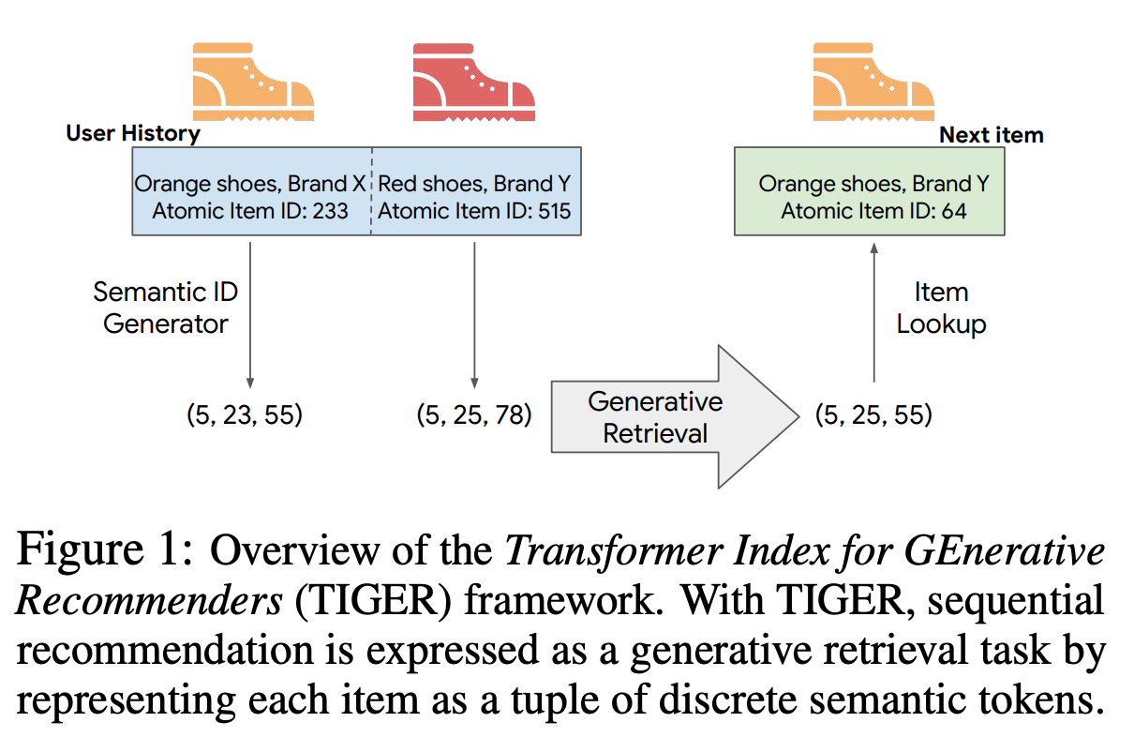
Joint Optimization for Discrete Representation
[1] Rajput, Shashank, et al. "Recommender systems with generative retrieval." NeurIPS’23
Notes:
TIGER introduces the generative retrieval paradigm for recommendation. Instead of retrieving items by nearest-neighbor search over vectors, the model generates the semantic ID of the next item.
The pipeline first tokenizes item content into discrete semantic IDs, often through a quantization-based tokenizer. Then a sequence-to-sequence model predicts the next item's ID token sequence from the user's history.
The limitation, from the joint optimization view, is that these semantic IDs are usually learned first and then frozen. The recommender can use them, but recommendation loss cannot directly refine the tokenizer. This is the gap DIGER addresses.

Slide 23
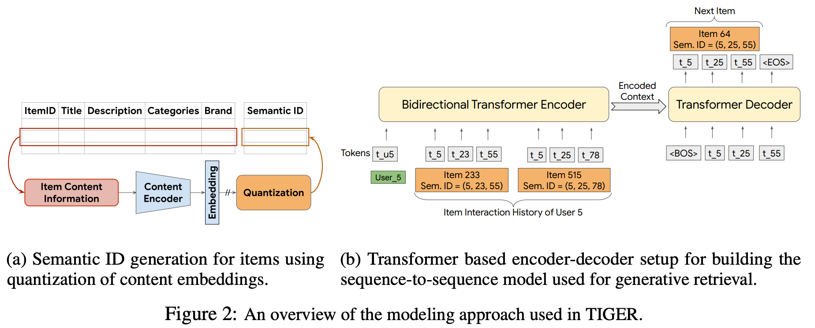
Joint Optimization for Discrete Representation
[1] Rajput, Shashank, et al. "Recommender systems with generative retrieval." NeurIPS’23
Notes:
TIGER introduces the generative retrieval paradigm for recommendation. Instead of retrieving items by nearest-neighbor search over vectors, the model generates the semantic ID of the next item.
The pipeline first tokenizes item content into discrete semantic IDs, often through a quantization-based tokenizer. Then a sequence-to-sequence model predicts the next item's ID token sequence from the user's history.
The limitation, from the joint optimization view, is that these semantic IDs are usually learned first and then frozen. The recommender can use them, but recommendation loss cannot directly refine the tokenizer. This is the gap DIGER addresses.

Slide 24
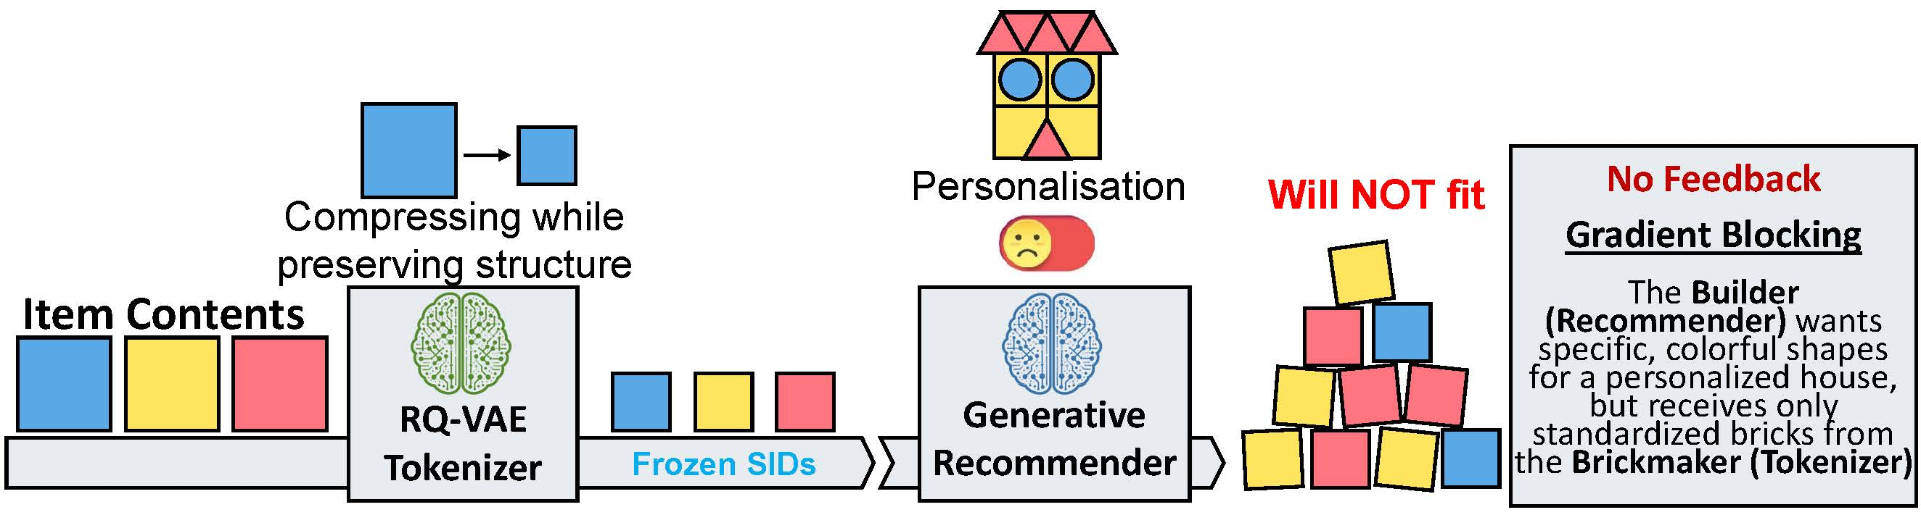
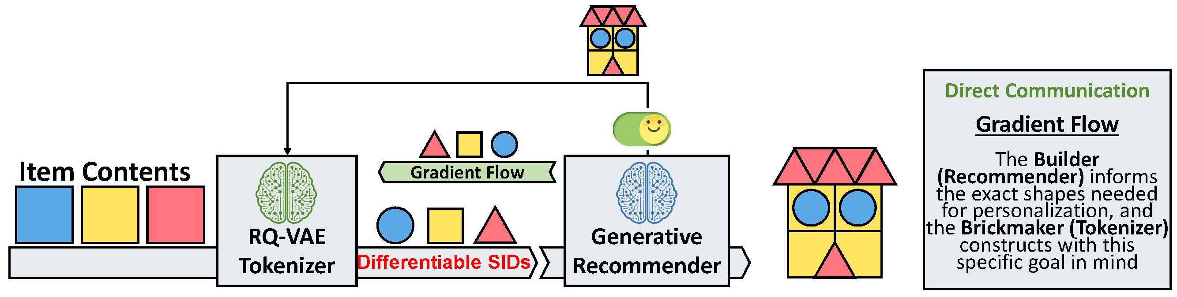
Differentiable Semantic ID (SID)
Joint Optimization for Discrete Representation
• What are the benefits of making semantic IDs differentiable?
• Enables joint optimization of SID and recommendation.
• Aligns SID tokenization with user preference and personalization signals.
Notes:
Making semantic IDs differentiable allows recommendation gradients to influence the tokenization process. The semantic ID is no longer just a fixed content-preserving code; it becomes aligned with user preference and personalization signals.
This is the main difference from continuous representation learning. For IISAN, IISAN-Versa, and CROSSAN, the target is a dense embedding space. For DIGER, the target is a discrete token space that also functions as the retrieval address in a generative model.
Therefore, the goal is to jointly optimize the tokenizer and the recommender while keeping the semantic ID space meaningful and usable for generation.

Slide 25
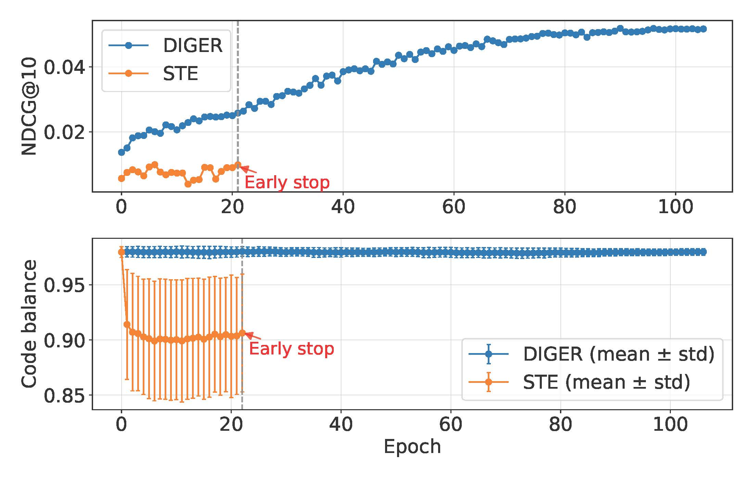
Limitations of Traditional STE
Joint Optimization for Discrete Representation
• Why not simply use the traditional Straight-Through Estimator (STE)?
• Vanilla STE is unstable: early saturation and code collapse.
• DIGER stabilizes training and preserves balanced code usage.
Notes:
A natural baseline is the Straight-Through Estimator, because it is commonly used to pass gradients through discrete quantization.
However, vanilla STE is unstable for this task. It can saturate early and concentrate assignments into a small part of the codebook, which leads to code collapse.
So in the discrete branch, simply making the semantic ID differentiable is not enough. The core bottleneck is stable joint optimization of tokenization and recommendation.

Slide 26
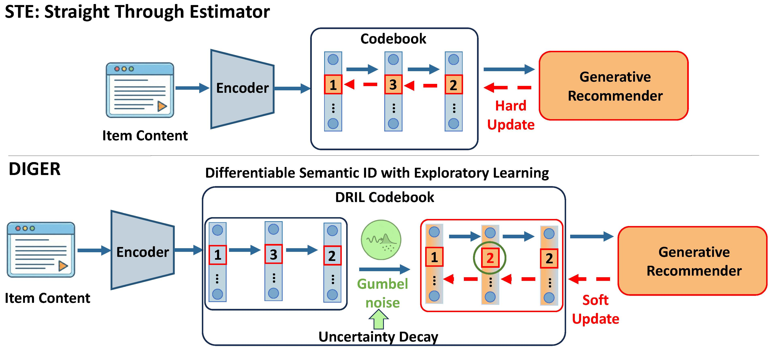
Joint Optimization for Discrete Representation
• How is DIGER implemented?
• DRIL introduces Gumbel-noise-based exploration in the codebook.
• Uncertainty decay shifts training from early exploration to later exploitation.
• DIGER uses soft code updates for smoother gradient flow.
Notes:
DIGER addresses the stability problem with exploratory learning. DRIL introduces Gumbel-noise-based exploration into codebook assignments.
At the beginning of training, stronger uncertainty encourages exploration of different codes. As training proceeds, uncertainty decay gradually shifts the model toward more deterministic assignments.
The soft code update provides smoother gradient flow than a hard STE update, which helps avoid early over-commitment and codebook collapse.

Slide 27
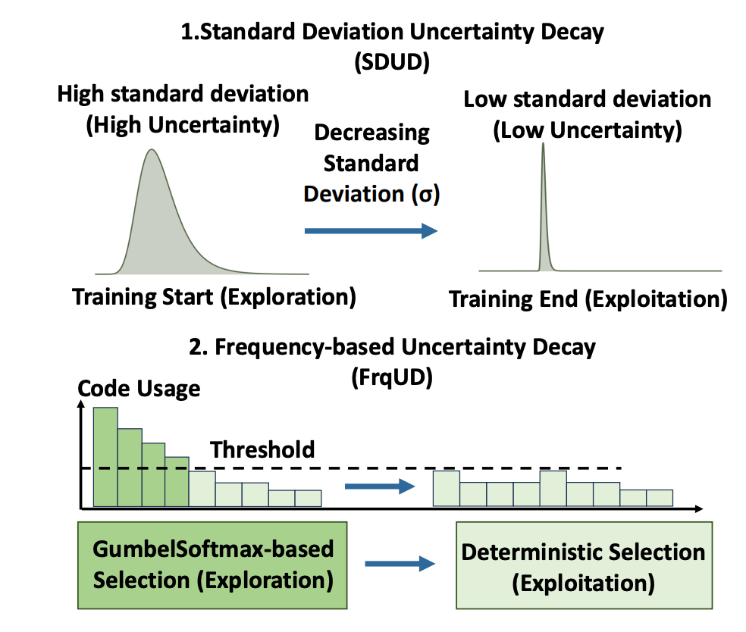
Joint Optimization for Discrete Representation
Notes:
DIGER addresses the stability problem with exploratory learning. DRIL introduces Gumbel-noise-based exploration into codebook assignments.
At the beginning of training, stronger uncertainty encourages exploration of different codes. As training proceeds, uncertainty decay gradually shifts the model toward more deterministic assignments.
The soft code update provides smoother gradient flow than a hard STE update, which helps avoid early over-commitment and codebook collapse.

Slide 28
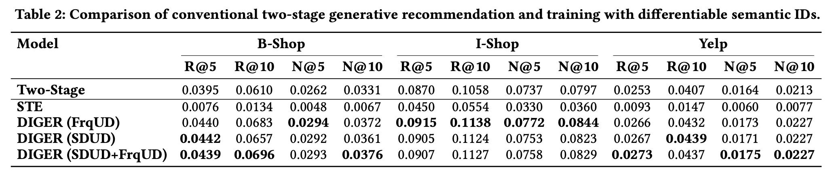
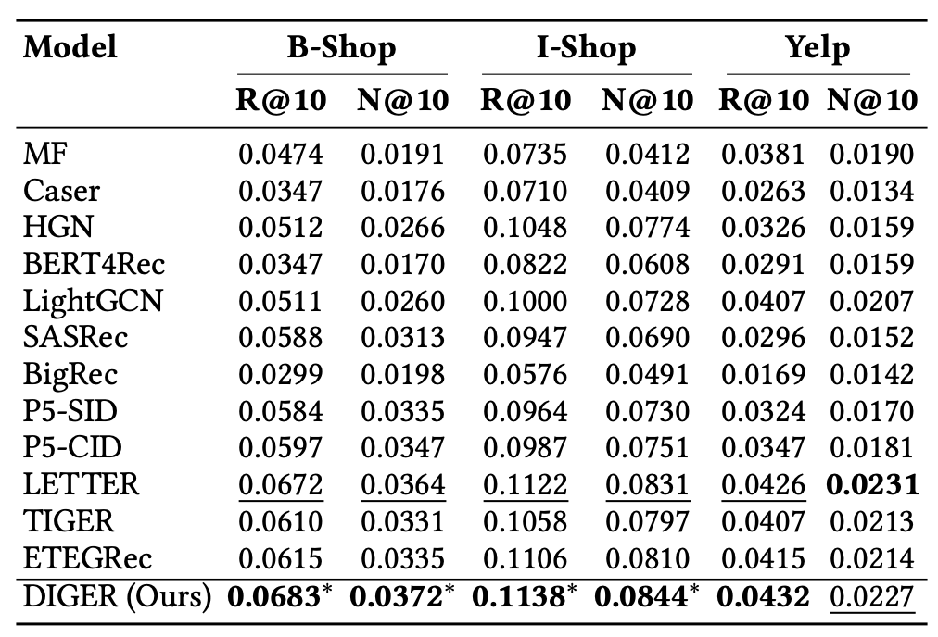
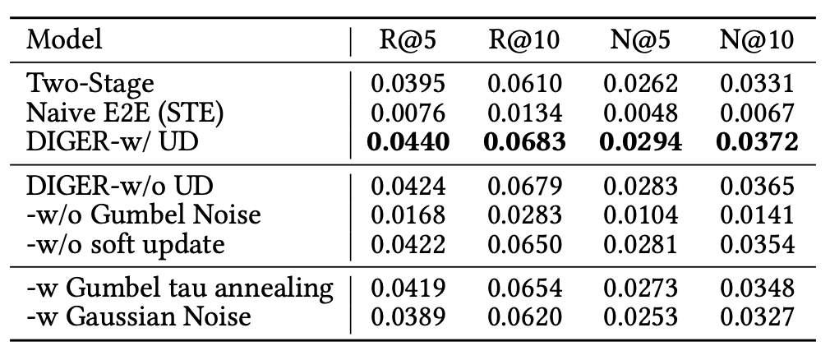
Joint Optimization for Discrete Representation
Notes:
The experiments show that DIGER improves recommendation performance over traditional two-stage frameworks and strong generative recommendation baselines.
It also maintains healthier code utilization, which is important because a collapsed codebook would make the semantic ID space less expressive.
The main takeaway is that stable differentiable semantic ID learning enables joint optimization in generative recommendation. This is the discrete counterpart to the continuous joint optimization methods discussed earlier.

Slide 29
Main Results and Key takeaways
Joint Optimization for Discrete Representation
• What do the experiments tell us about DIGER?
• DIGER outperforms traditional two-stage frameworks.
• It improves recommendation accuracy while maintaining healthier code utilization.
• What are the key takeaways from this paper?
• Stable differentiable semantic ID learning is more effective than frozen or vanilla STE-based designs.
• Gumbel-noise exploration is critical for avoiding semantic ID collapse.
• Joint optimization of tokenization and recommendation is a promising direction for generative recommendation.
Notes:
The experiments show that DIGER improves recommendation performance over traditional two-stage frameworks and strong generative recommendation baselines.
It also maintains healthier code utilization, which is important because a collapsed codebook would make the semantic ID space less expressive.
The main takeaway is that stable differentiable semantic ID learning enables joint optimization in generative recommendation. This is the discrete counterpart to the continuous joint optimization methods discussed earlier.

Slide 30
Conclusions and Key Takeaways
1. Joint optimization provides a unified lens for multimodal recommendation.
2. For continuous representations, the core bottleneck is efficiency: memory, training time, and encoder asymmetry.
3. IISAN, IISAN-Versa, and CROSSAN make continuous representation learning more practical across depth and modality breadth.
4. For discrete representations, DIGER enables stable joint optimization of semantic IDs and generative recommendation.
Notes:
The final synthesis is that joint optimization is the common lens for both branches of the talk.
For continuous representations, the main bottlenecks are efficiency, encoder asymmetry, and modality breadth. IISAN, IISAN-Versa, and CROSSAN address these issues while keeping dense representations aligned with recommendation objectives.
For discrete representations, the main bottleneck is codebook stability. DIGER addresses this by making semantic IDs differentiable and stabilizing their optimization with the generative recommender.

Slide 31

Thanks for your attention!
Q&A
Notes:
This closes the presentation. The audience should now see multimodal recommendation as a representation optimization problem rather than only a feature fusion problem.
A useful discussion question is which trade-off matters most in real systems: accuracy, training efficiency, inference latency, cold-start generalization, or interpretability of semantic IDs.
Questions are welcome on the continuous branch, the discrete semantic ID branch, or the broader role of foundation models in recommender systems.

