Slide 1



Leveraging Foundation Models for Multimodal Recommendation
Junchen Fu
PhD Candidate
University of Glasgow
May 8th 2026
Personal Homepage:
https://junchen-fu.github.io/
Notes:
On this opening slide, we introduce the topic of the lecture: leveraging foundation models for multimodal recommendation.
The motivation is that modern recommender systems are no longer limited to user-item IDs or interaction logs. Items in real systems usually come with rich content, such as product titles, descriptions, images, videos, audio, captions, and reviews.
At the same time, foundation models have become very powerful representation learners across different modalities. The main question for this talk is how these models can be used or adapted for recommendation tasks.
The lecture will move from conventional multimodal feature usage, to end-to-end adaptation of multimodal foundation models, and finally to multimodal generative recommendation.
So the key message from the beginning is that foundation models are changing multimodal recommendation from a feature engineering problem into a representation learning and adaptation problem.

Slide 2
Table of Content
Background
Multimodal Features as Auxiliary Signals
End-to-End Multimodal Recommendation
Multimodal Generative Recommendation
Conclusions and Key Takeaways
Notes:
On this slide, we outline the structure of the talk.
We start with the background, where we define multimodalities and foundation models in the recommendation context.
Then we discuss multimodal features as auxiliary signals. This part covers the classical line of work, where visual, textual, audio, or video features are usually extracted first and then injected into a recommender model.
After that, we move to end-to-end multimodal recommendation. Here the focus shifts from fixed feature extraction to adapting large pre-trained modality encoders, such as BERT, ViT, and LLMs, for recommendation tasks.
The fourth part is multimodal generative recommendation, where models generate item identifiers or semantic tokens instead of only scoring existing item embeddings.
Finally, we summarize the main takeaways and discuss what these trends imply for future recommender systems.

Slide 3



Background
What are multimodalities in recommendation scenario?
E-commerce Product Recommendation
Video Recommendation
In recommendation scenarios, multimodalities refer to different types of content signals that describe an item.
Notes:
On this slide, we first define what multimodalities mean in recommendation scenarios.
In many recommendation tasks, an item is not represented by only one type of information. For example, in e-commerce, a product may have a textual title and description, product images, demonstration videos, and sometimes audio from video content. These correspond to four common modalities: text, image, video, and audio.
The same idea applies to video recommendation. A video contains visual frames, audio signals, textual titles or captions, and sometimes thumbnails or key frames.
Each modality describes the item from a different perspective. Text tells us the semantic meaning, images show visual appearance, videos capture temporal dynamics, and audio provides speech or sound information.
So, multimodal recommendation is about using these different modalities together to build a more comprehensive understanding of items and improve recommendation quality.

Slide 4
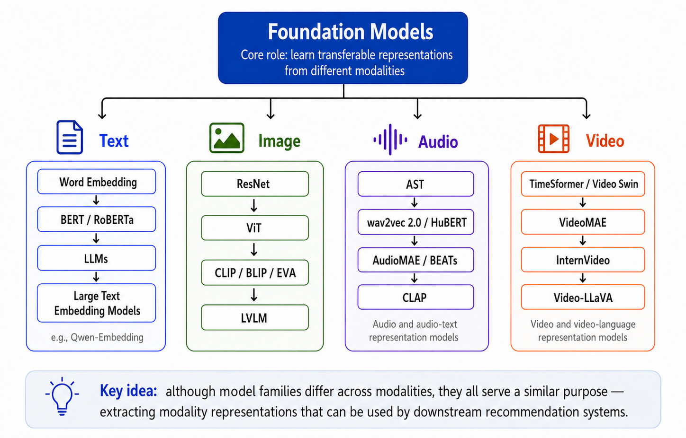
Background
What are foundation models?
Notes:
On this slide, we define what foundation models mean in our recommendation context.
Foundation models are a broad family of models trained on large-scale data. Their key function is to learn transferable representations, which means the learned representations can be reused for many downstream tasks.
Here, we focus on four common modalities: text, image, audio, and video.
For text, we can see an evolution from word embeddings, to BERT and RoBERTa, then to LLMs and large text embedding models. These models help us encode product titles, descriptions, reviews, captions, and user queries.
For images, the evolution goes from ResNet, to ViT, then to vision-language models such as CLIP, BLIP, EVA, and LVLMs. These models can extract visual and semantic representations from product images, thumbnails, and visual content.
For audio, models such as AST, wav2vec 2.0, HuBERT, AudioMAE, BEATs, and CLAP can capture speech, sound, and audio-text semantics.
For video, models such as TimeSformer, Video Swin, VideoMAE, InternVideo, and Video-LLaVA can represent dynamic visual content and video-language information.
So the main takeaway is simple: foundation models may look different across modalities, but they all help us convert raw multimodal content into useful representations. These representations can then be used by recommendation systems for retrieval, ranking, matching, and personalization

Slide 5
Table of Content
Background
Multimodal Features as Auxiliary Signals
End-to-End Multimodal Recommendation
Multimodal Generative Recommendation
Conclusions and Key Takeaways
Notes:
This slide marks the transition from the background section to the first technical part of the lecture.
In the previous background slides, we introduced what multimodalities are and why foundation models matter for recommendation.
Now we begin with the classical and widely used setting: multimodal features as auxiliary signals.
In this setting, the recommender model itself is usually still built around user-item interactions, item IDs, graph structures, or sequential models. Multimodal information is added as extra side information to improve item representations or graph construction.
This section is important because it gives us the historical baseline. It shows how multimodal recommendation was typically formulated before the recent move toward end-to-end foundation-model adaptation.

Slide 6
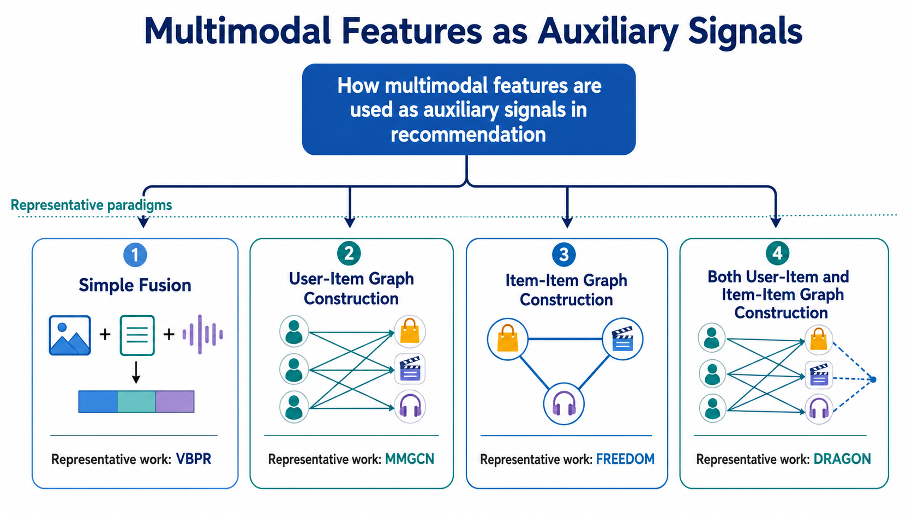
Multimodal Features as Auxiliary Signals
Notes:
On this slide, we summarize the main ways multimodal features are used as auxiliary signals in recommendation.
The first paradigm is simple fusion. Here, features from different modalities, such as images, text, and audio, are extracted independently and then concatenated or combined with ID embeddings.
The second paradigm uses multimodal features to construct or enhance the user-item graph. This is common in graph-based recommendation, where different modalities can define modality-specific user-item relations.
The third paradigm constructs item-item graphs. The intuition is that multimodal content can reveal semantic similarity between items, even when user interactions are sparse.
The fourth paradigm combines both user-item and item-item graph construction, so the model can exploit collaborative signals and content-based semantic structures at the same time.
The takeaway is that in these methods, multimodal encoders are usually used before recommendation training. The extracted features help the recommender, but they are not necessarily adapted end-to-end for the recommendation objective.

Slide 7
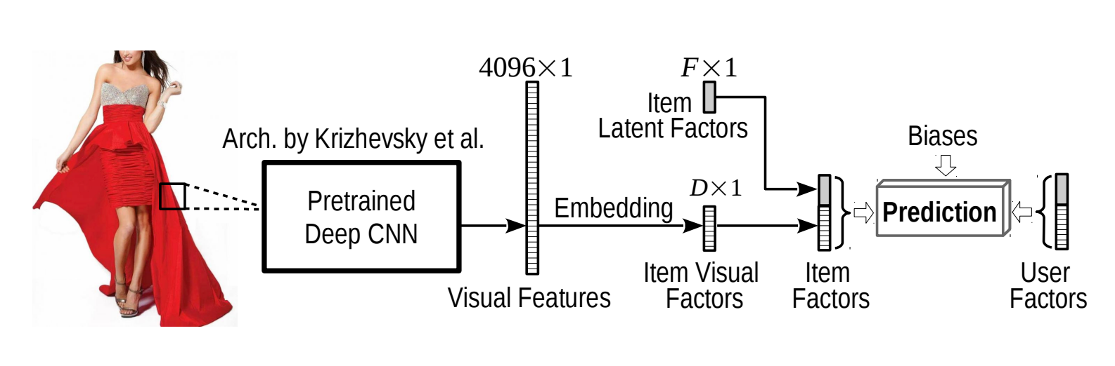
Multimodal Features as Auxiliary Signals
VBPR: Integrating Multimodalites using simple fusion
He, R., & McAuley, J. (2016, February). VBPR: visual bayesian personalized ranking from implicit feedback. AAAI2016
Notes:
On this slide, we look at VBPR, one of the earliest and most influential examples of using visual information in recommendation.
VBPR stands for Visual Bayesian Personalized Ranking. The paper extends the BPR framework by incorporating visual features extracted from product images using a pre-trained CNN.
The figure shows the basic idea. An item image is passed through a deep CNN to produce visual features. These features are transformed into visual factors and then combined with traditional item latent factors and user factors for prediction.
The important point is that the image encoder is not trained for recommendation from scratch. Instead, it acts as a feature extractor, and the recommender learns how user preferences interact with those visual dimensions.
This is a typical simple-fusion approach. It demonstrates that visual appearance can explain part of user preference, especially in domains such as fashion or products where style and appearance matter.
So VBPR is useful as a starting point because it shows the classical role of multimodal features: they enrich item representation, but the recommendation model remains largely ID-based and factorization-based.

Slide 8
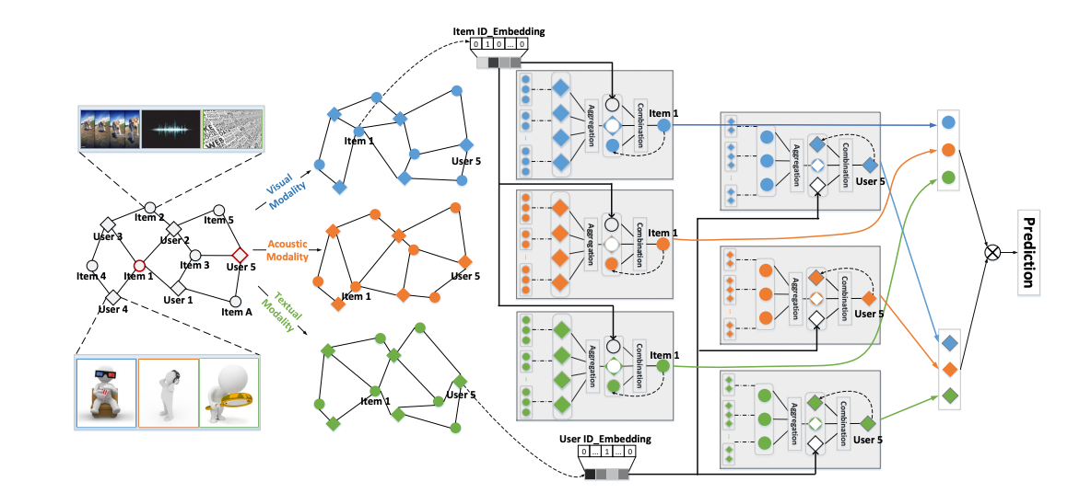
Multimodal Features as Auxiliary Signals
MMGCN: Integrating Multimodalites as User-Item Graph construction.
Wei, Y., Wang, X., Nie, L., He, X., Hong, R., & Chua, T. S. (2019, October). MMGCN: Multi-modal graph convolution network for personalized recommendation of micro-video. MM’2019.
Notes:
On this slide, we move from simple feature fusion to graph-based multimodal recommendation, using MMGCN as the example.
MMGCN is designed for personalized micro-video recommendation. Micro-videos naturally contain multiple modalities, such as visual content, acoustic signals, and textual descriptions.
The key idea of MMGCN is to build modality-specific user-item graphs. Instead of treating all modalities as one fused feature vector, the model propagates information separately in visual, acoustic, and textual graphs.
Through graph convolution, users and items can exchange information in each modality. This allows the model to learn modal-specific user preferences. For example, a user may prefer the visual style of some videos but the audio style of others.
After learning representations from different modalities, the model combines them for final recommendation prediction.
This slide shows an important development: multimodal features are no longer only appended to item embeddings. They are used to structure the message-passing process between users and items.

Slide 9
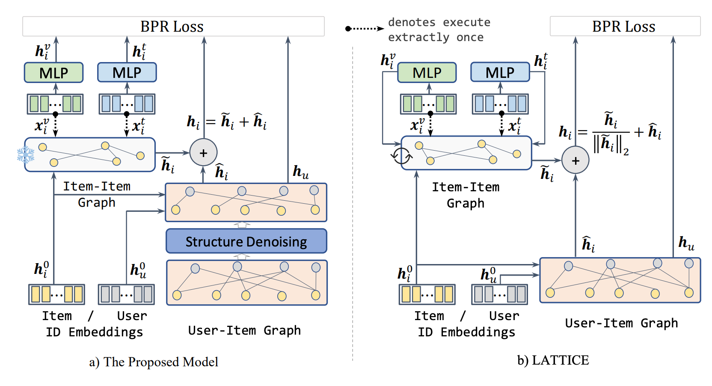
Multimodal Features as Auxiliary Signals
FREEDOM: Integrating into Item-Item Graph construction
Zhou, H., Zhou, X., Zhang, L., & Shen, Z. (2023). Zhou, X., & Shen, Z. (2023, October). A tale of two graphs: Freezing and denoising graph structures for multimodal recommendation. MM’23
Notes:
On this slide, we discuss item-item graph construction, using the FREEDOM model from the paper 'A Tale of Two Graphs' as the example.
The background here is that methods such as LATTICE construct item-item graphs from multimodal features. These graphs capture semantic similarity between items based on content, such as image or text embeddings.
The FREEDOM paper makes an interesting observation: dynamically learning the latent item-item graph during training can be expensive and may not be necessary. Instead, the item-item graph can be constructed once and then frozen.
At the same time, FREEDOM denoises the user-item interaction graph. This matters because implicit feedback can contain noisy interactions, and noisy edges may harm graph propagation.
The figure compares the proposed FREEDOM pipeline with LATTICE. The main message is that item-item semantic structure can be reused efficiently, while the user-item graph should be cleaned to reduce noise.
So this slide highlights a key principle in auxiliary-signal methods: multimodal features can reveal stable item semantics, while collaborative interactions may require denoising.

Slide 10
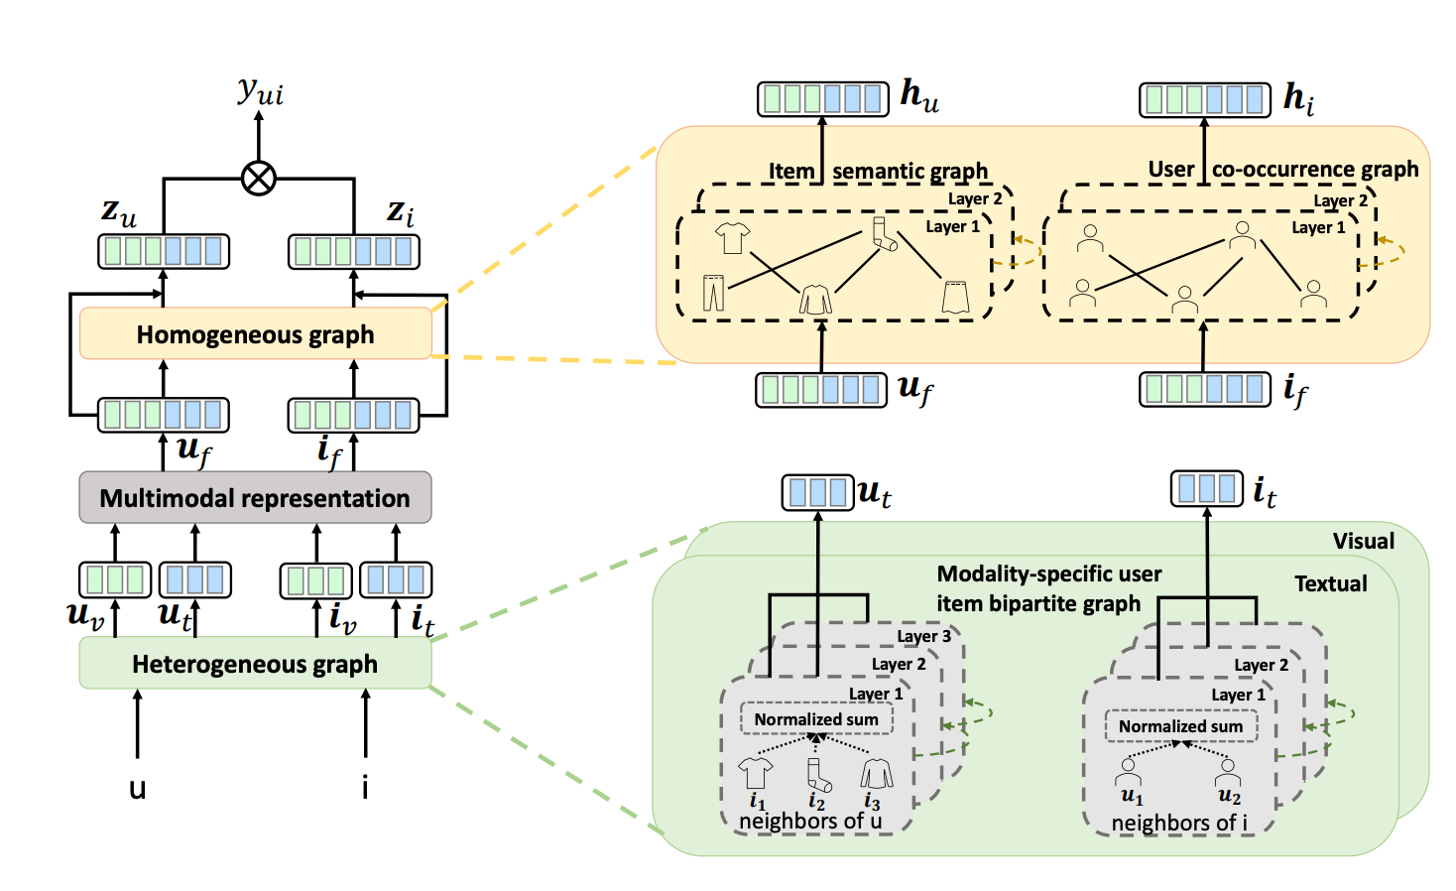
Multimodal Features as Auxiliary Signals
DRAGON: Integrating into Both Item-Item Graph and User-Item Graph construction
Zhou, H., Zhou, X., Zhang, L., & Shen, Z. (2023). Enhancing dyadic relations with homogeneous graphs for multimodal recommendation. ECAI'23.
Notes:
On this slide, we introduce DRAGON, which integrates multimodal information into both item-item and user-item graph modeling.
The paper argues that user-item interactions are dyadic relations: recommendation depends on both user-side and item-side representations. Many previous multimodal graph models only strengthen one side, such as item-item relations, while leaving the other side under-modeled.
DRAGON addresses this by constructing homogeneous graphs for both users and items. The user-user graph is built from common interacted items, while the item-item graph is built from multimodal item features.
The model then combines these homogeneous graphs with the original heterogeneous user-item graph. In this way, user representations and item representations are both enhanced by high-order relational information.
The figure shows how multimodal representations flow into graph construction and then into final user-item prediction.
This slide completes the graph-based story: multimodal features can be used not only as item attributes, but also as signals for constructing richer graph structures on both sides of the recommendation problem.

Slide 11
Multimodal Features as Auxiliary Signals
Model Families
Group 1 Simple fusion
Group 2 User-item graphs
VBPR, BM3
GRCN, DualGNN, MMGCN, SLMRec, LGMRec
Group 3 Item-item graphs
Group 4 Hybrid graphs
LATTICE, FREEDOM, MGCN, DA-MRS, SMORE
DRAGON, PGL
Notes:
On this slide, we organize the auxiliary-signal literature into four model families.
Group 1 is simple fusion. These methods, such as VBPR and BM3, extract visual or textual features first and then combine them with collaborative embeddings. This is easy to implement and often strong as a baseline, but the multimodal information is usually injected only at the representation level.
Group 2 is user-item graph modeling. Methods such as GRCN, DualGNN, MMGCN, SLMRec, and LGMRec use modality-aware user-item graphs or graph convolution to propagate multimodal preference signals between users and items.
Group 3 is item-item graph modeling. LATTICE, FREEDOM, MGCN, DA-MRS, and SMORE focus on constructing item-item relations from multimodal content, so semantically similar items can support each other even when user interactions are sparse.
Group 4 is hybrid graph modeling. Methods such as DRAGON and PGL combine multiple graph views, for example item-item relations and user-item relations, to capture both content similarity and collaborative preference structure.
The main message is that multimodal features can enter the recommender at different locations: as fused embeddings, as user-item propagation signals, as item-item similarity graphs, or as hybrid graph structures. This taxonomy helps us understand the papers discussed in the previous slides and motivates the reproducibility question on the next slide.

Slide 12
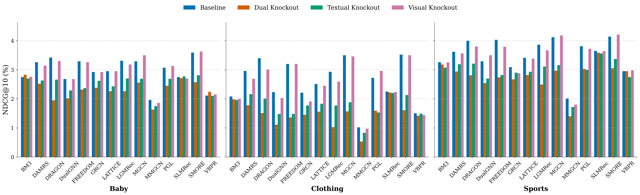
Multimodal Features as Auxiliary Signals
Reproducibility Study
Ye, Y., Fu, J., Song, Y., Zheng, K., & Jose, J. M. (2026, March). Are multimodal embeddings truly beneficial for recommendation? A deep dive into whole vs. individual modalities. ECIR’26
Notes:
On this slide, we present a reproducibility and empirical study asking a very direct question: are multimodal embeddings truly beneficial for recommendation?
This paper studies multimodal recommendation models using a modality knockout strategy. Instead of only comparing full models, it removes or perturbs specific modalities to test whether text and visual embeddings are actually contributing.
The bar charts compare the original baseline setting with dual knockout, textual knockout, and visual knockout across several models and datasets, including Baby, Clothing, and Sports.
The key finding is nuanced. Multimodal embeddings can help, especially when they are integrated through stronger graph-based fusion mechanisms. However, the benefit is not uniform across all models.
A particularly important observation is that text alone often performs close to the full multimodal setting, while image-only signals are frequently weaker. This challenges the assumption that simply adding more modalities always improves recommendation.
So the takeaway is that multimodal recommendation needs careful evaluation. We should ask not only whether multimodal features are used, but also which modality is useful, under which model design, and in which dataset.

Slide 13
Multimodal Features as Auxiliary Signals
Reproducibility Study
1
Report modality ablations
2
Text is the strongest baseline
A simple knockout test is a far better sanity check than claiming gains from a stronger backbone alone.
If compute or data is limited, strong text plus collaborative signals may already capture most of the benefit.
3
Be careful with simple fusion baselines
Some gains can come from architecture artifacts or numerical effects rather than real multimodal learning.
Ye, Y., Fu, J., Song, Y., Zheng, K., & Jose, J. M. (2026, March). Are multimodal embeddings truly beneficial for recommendation? A deep dive into whole vs. individual modalities. ECIR’26
Notes:
On this slide, we summarize the practical lessons from the reproducibility study.
The first lesson is to report modality ablations. A model may claim that multimodal information improves recommendation, but without removing or knocking out individual modalities, it is difficult to know whether the gain actually comes from text, image, both modalities, or simply from a stronger backbone.
The second lesson is that text is often a very strong baseline. In many recommendation datasets, item titles, descriptions, tags, and category information already encode much of the semantic signal that the recommender needs. Therefore, when compute or data is limited, a strong text representation combined with collaborative signals may capture a large portion of the multimodal benefit.
The third lesson is to be cautious with simple fusion baselines. Concatenation or summation can sometimes produce improvements because of changes in dimensionality, regularization, optimization, or numerical scale, rather than because the model has genuinely learned useful cross-modal interactions.
For future experiments, the recommended checklist is simple: compare against strong single-modality baselines, report whole-modality and individual-modality knockouts, and separate architectural gains from true multimodal gains. This makes empirical claims in multimodal recommendation more reliable.

Slide 14
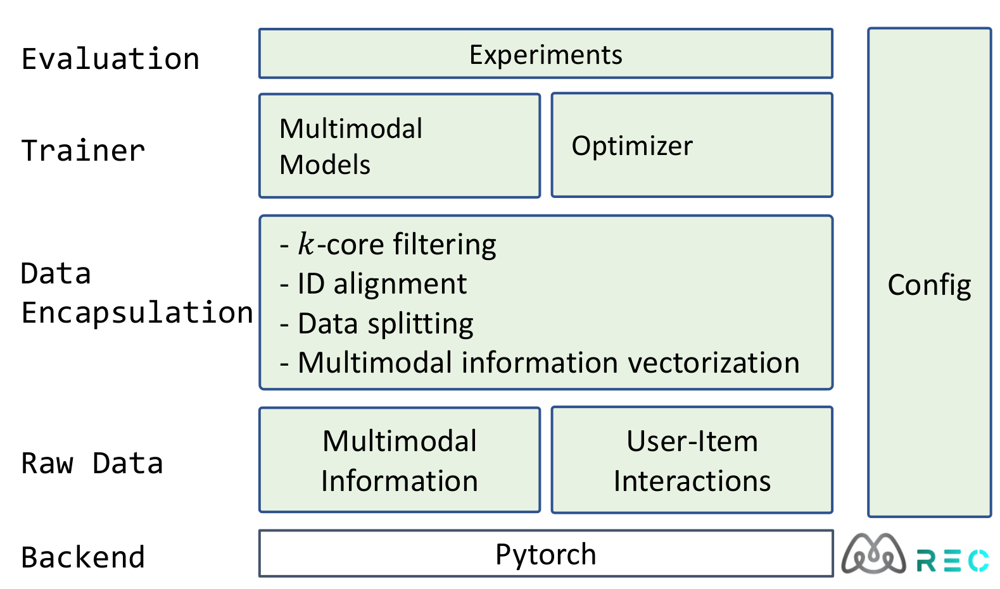
Multimodal Features as Auxiliary Signals
MMRec - Experiment Framework
https://github.com/enoche/mmrec
Notes:
On this slide, we introduce MMRec as an experimental framework for multimodal recommendation.
A major challenge in this area is reproducibility. Different papers often use different preprocessing pipelines, data splits, feature extraction methods, evaluation protocols, and implementation details.
MMRec aims to standardize this process. The framework organizes the workflow into raw data, data encapsulation, trainer, evaluation, and configuration modules.
On the data side, it supports operations such as k-core filtering, ID alignment, data splitting, and multimodal information vectorization. These steps are crucial because multimodal recommendation results can be highly sensitive to preprocessing.
On the model side, it provides a unified PyTorch-based backend for training and evaluating multimodal recommendation models.
The main takeaway is that as multimodal recommendation becomes more complex, toolkits like MMRec are important for fair comparison, reproducible experimentation, and faster development of new methods.

Slide 15
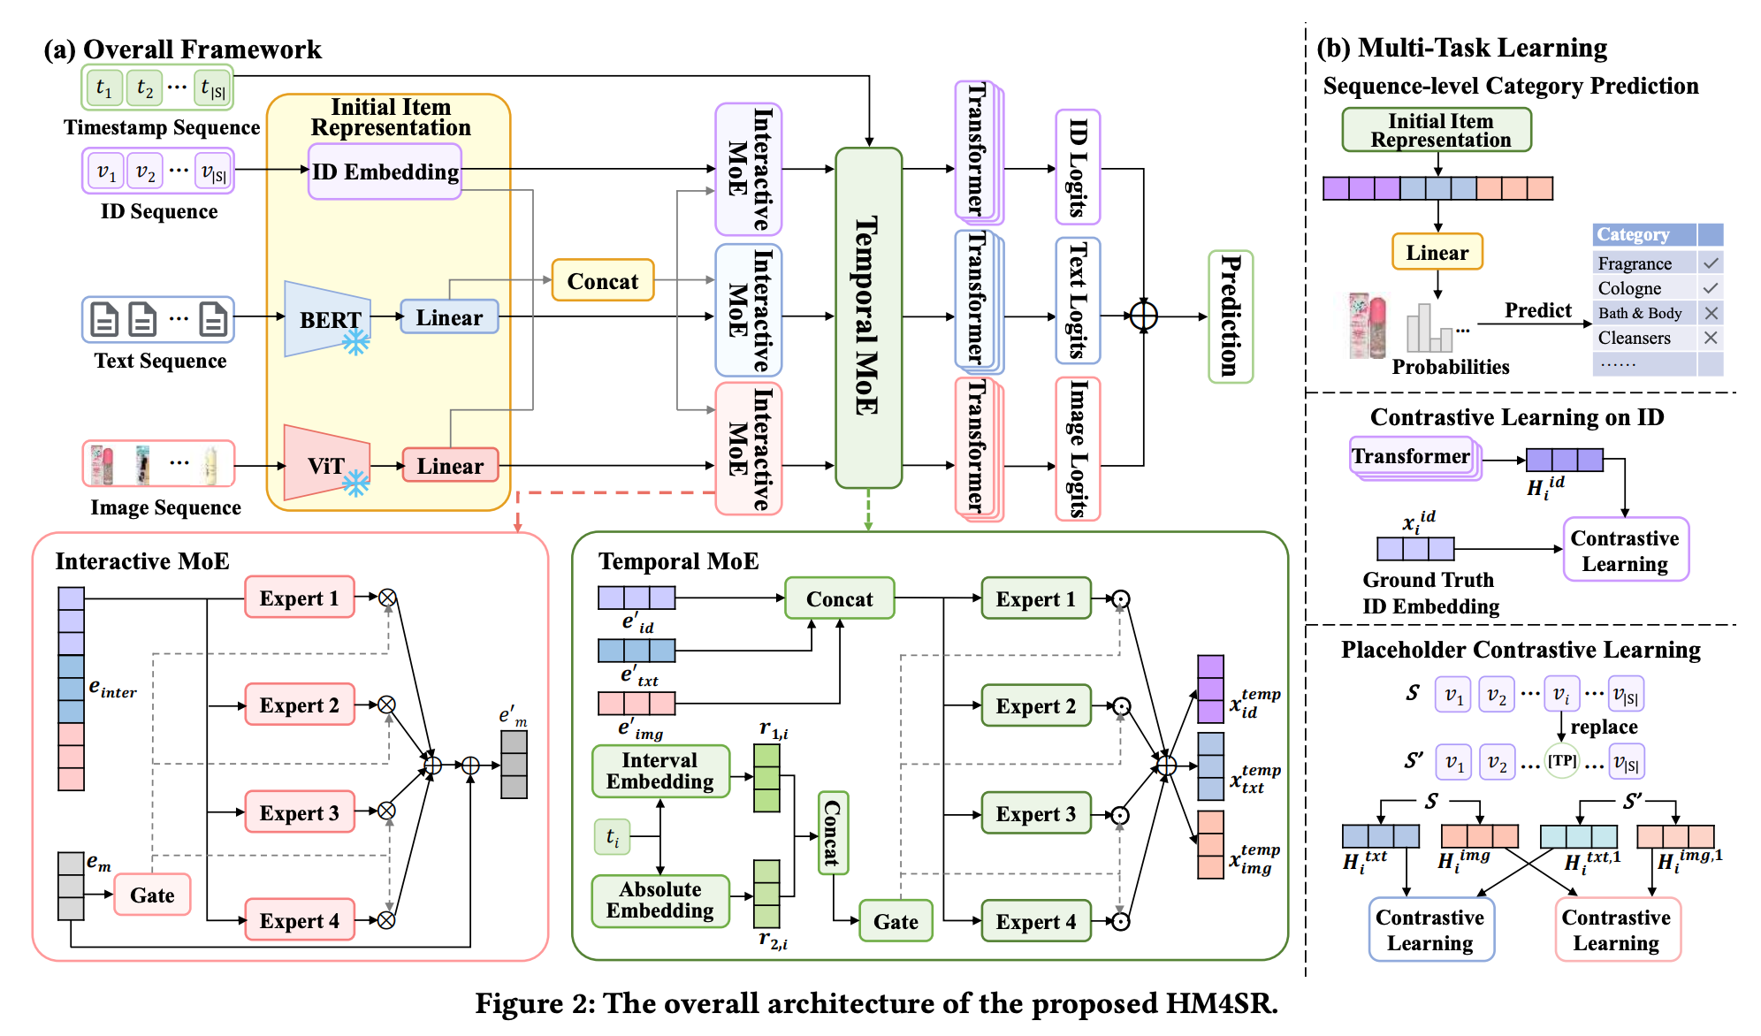
Multimodal Features as Auxiliary Signals
Multimodal features as auxiliary signals in sequential recommendation domain.
Zhang, Shengzhe, et al. "Hierarchical time-aware mixture of experts for multi-modal sequential recommendation." WWW’25.
Notes:
On this slide, we briefly connect auxiliary multimodal signals to the sequential recommendation setting.
The figure shows HM4SR, a Hierarchical Time-Aware Mixture of Experts model for multimodal sequential recommendation.
The task here is not only to recommend items based on static user-item interactions, but to predict the next item from a user's historical sequence. This makes temporal order and user interest evolution important.
HM4SR uses BERT to encode textual information, ViT to encode image information, and ID embeddings to preserve collaborative signals. Then it applies a hierarchical mixture-of-experts design.
The Interactive MoE is used to extract useful multimodal interest information, while the Temporal MoE incorporates explicit time signals, such as timestamps and intervals. The right side also shows auxiliary multi-task learning and contrastive learning objectives.
This slide shows that even in sequential recommendation, multimodal features are often treated as auxiliary representations. They help enrich item states and model user interests, but the central task is still sequence-based next-item prediction.

Slide 16
Conclusions and Key takeaways
Multimodal features enrich traditional ID-based recommenders.
Main designs: simple fusion, user-item graphs, item-item graphs, and hybrid graphs.
Text often provides the strongest and most stable signal.
More modalities do not always guarantee better recommendation performance.
Modality ablation is necessary for fair evaluation.
Notes:
This section shows the classical way of using multimodal information in recommendation. Text, image, audio, and video features are usually extracted first and then injected into an existing recommender model as auxiliary signals. These features can improve item representation, construct user-item graphs, or build item-item semantic relations. However, the key takeaway is that multimodal features are not automatically useful. Their contribution depends on the modality, dataset, and model design. Therefore, careful ablation and reproducible evaluation are essential.

Slide 17
Table of Content
Background
Multimodal Features as Auxiliary Signals
End-to-End Multimodal Recommendation
Multimodal Generative Recommendation
Future Work and Discussion
Notes:
This slide marks the transition into the second major technical part: end-to-end multimodal recommendation.
The previous section focused on using multimodal features as auxiliary signals. In most of those methods, images or text are encoded first, and the extracted embeddings are then consumed by a recommender model.
The limitation is that the multimodal encoder may not be optimized for recommendation. A feature extractor trained for image classification or language modeling may not capture the user preference signals that matter for ranking items.
In this section, we shift to a more ambitious setting. We ask whether foundation models such as BERT, ViT, GPT-style models, and large multimodal encoders can be adapted directly to recommendation tasks.
This shift introduces new opportunities, such as transferable item representations and stronger cold-start ability, but also new challenges, especially high training cost, memory cost, and modality-specific adaptation design.

Slide 18
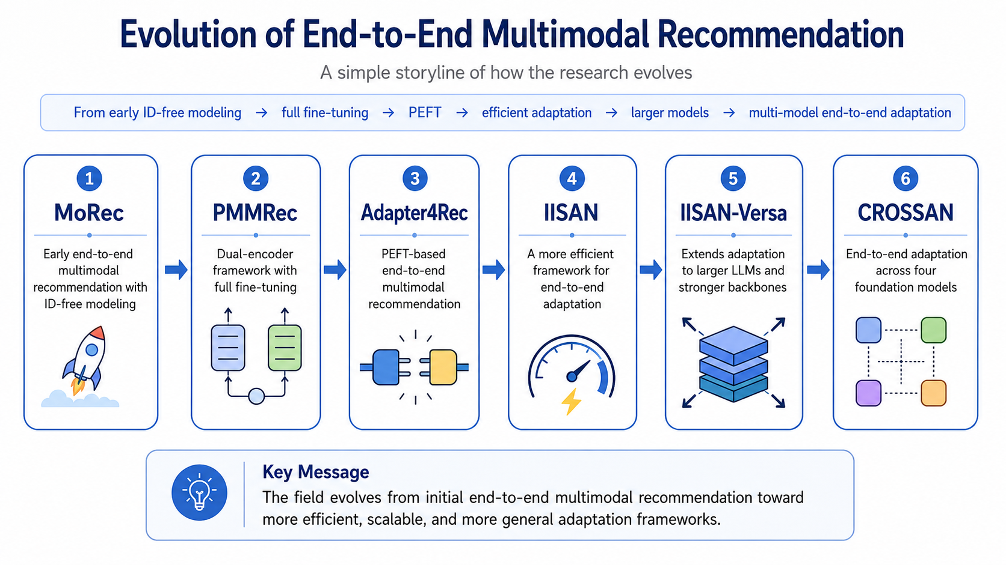
End-to-End Multimodal Recommendation
Notes:
On this slide, we summarize the research storyline of end-to-end multimodal recommendation.
The key idea is that this line of work gradually evolves from basic end-to-end multimodal modeling toward more efficient, scalable, and general adaptation frameworks.
First, MoRec represents an early step in this direction. It studies end-to-end multimodal recommendation with ID-free modeling, where the model relies more directly on item content instead of traditional item IDs.
Then, PMMRec moves to a dual-encoder framework and performs full fine-tuning. This shows that foundation encoders can be directly adapted for recommendation tasks, but full fine-tuning can be expensive.
Next, Adapter4Rec introduces PEFT, or parameter-efficient fine-tuning, into end-to-end multimodal recommendation. Instead of updating the whole foundation model, it updates small adapter modules, making adaptation more practical.
After that, IISAN further improves efficiency. Its main contribution is to make end-to-end adaptation much cheaper while still maintaining strong recommendation performance.
Then, IISAN-Versa extends this idea to larger LLMs and stronger backbone models. This is important because real-world foundation models are often asymmetric, especially when text encoders are much deeper than vision encoders.
Finally, CROSSAN broadens the framework from adapting one or two models to adapting multiple foundation models end-to-end. This moves the field toward more general multimodal recommendation systems that can handle richer modalities and model combinations.
So the main takeaway is: end-to-end multimodal recommendation is not only about using foundation models, but also about how to adapt them efficiently and scalably for recommendation. The whole progression goes from ID-free modeling, to full fine-tuning, to PEFT, then to efficient adaptation, larger models, and finally multi-model end-to-end adaptation.

Slide 19
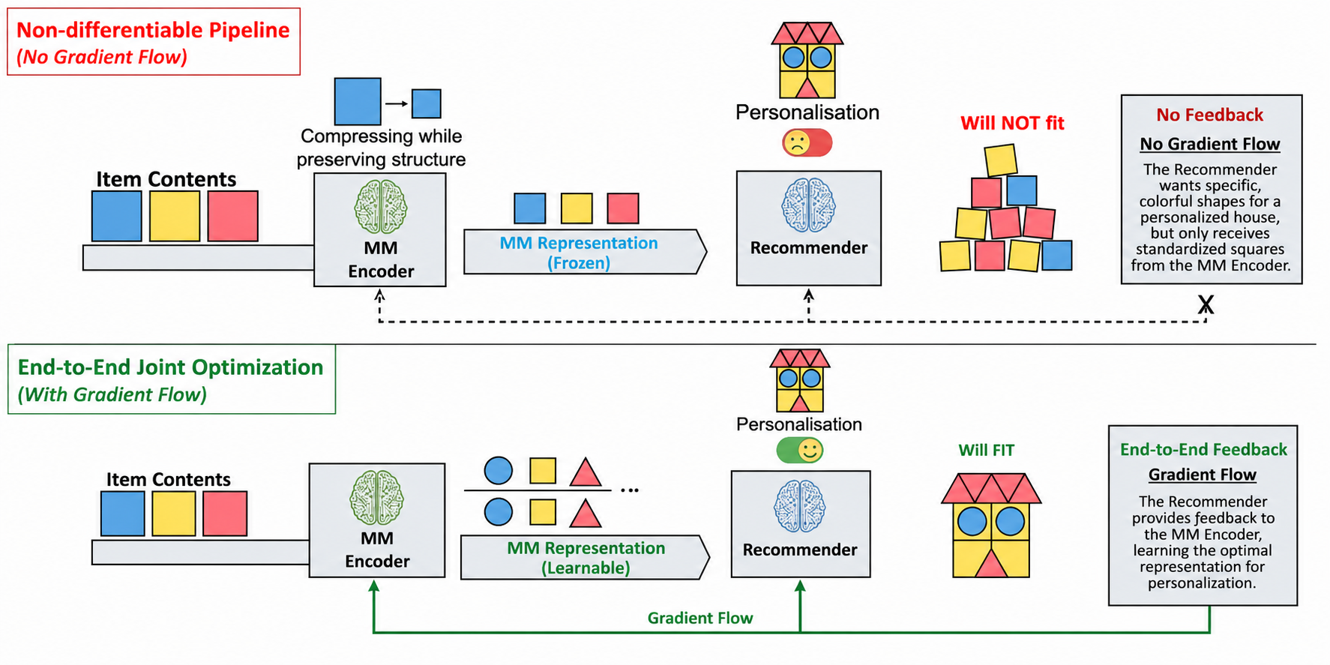
End-to-End Multimodal Recommendation
Fu, Junchen, et al. "Differentiable Semantic ID for Generative Recommendation." SIGIR’26.
Notes:
Metaphor. MM encoder is the brickmaker, the recommender is a builder, no gradient flow makes the MM encoder like a compressing while preserving structure procedure but no personilised signal is incorporated.

Slide 20
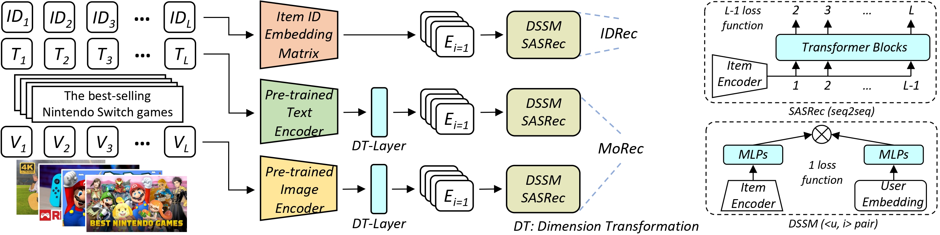
End-to-End Multimodal Recommendation
MoRec: Foundational models (BERT, ViT, GPT) are adapted in an end-to-end manner for downstream tasks such as recommendation.
[1] Zheng Yuan, Fajie Yuan, Yu Song, Youhua Li, Junchen Fu, Fei Yang, Yunzhu Pan, and Yongxin Ni. "Where to go next for recommender systems? id-vs. modality-based recommender models revisited." SIGIR’23.
Notes:
On this slide, we introduce the motivation for end-to-end multimodal recommendation through the IDRec versus MoRec discussion.
Traditional recommender systems are often ID-based. They learn embeddings for users and items from interaction data, which is highly effective when items have enough historical feedback.
The paper 'Where to Go Next for Recommender Systems?' revisits whether modality-based recommenders can challenge ID-based recommenders when we use modern pre-trained text and image encoders.
The figure contrasts ID-based item representations with modality-based item representations. For the modality-based path, item titles and images are passed into pre-trained encoders, followed by dimension transformation layers and sequential recommenders such as SASRec.
The key insight is that with strong foundation models and end-to-end training, modality-based recommenders can become competitive with ID-based models, even in settings where ID-based methods are traditionally strong.
This slide sets up the core question of the section: if foundation models can represent raw item content well, how should we adapt them efficiently for recommendation?

Slide 21
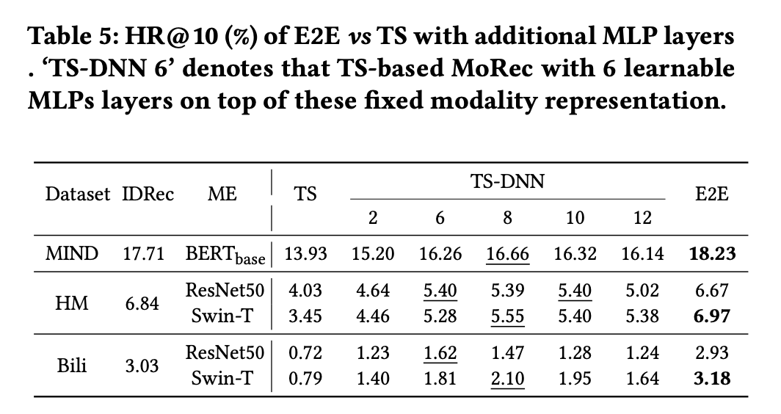
End-to-End Multimodal Recommendation
TS (Two-stage) vs. E2E (End-to-end)
[1] Zheng Yuan, Fajie Yuan, Yu Song, Youhua Li, Junchen Fu, Fei Yang, Yunzhu Pan, and Yongxin Ni. "Where to go next for recommender systems? id-vs. modality-based recommender models revisited." SIGIR’23.
Notes:
TS is way worse than E2E even with many dnn layers on top.

Slide 22
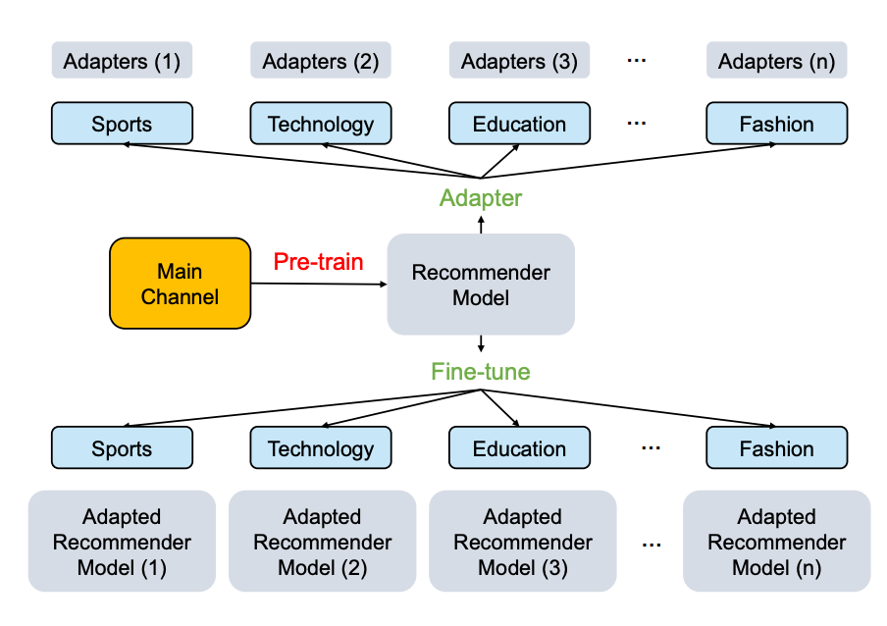
End-to-End Multimodal Recommendation
Adapter4Rec: End-to-end adaptation can also empower cross-domain transfer learning.
[1] Fu, Junchen, et al. "Exploring adapter-based transfer learning for recommender systems: Empirical studies and practical insights." WSDM’24.
Notes:
On this slide, we introduce adapter-based transfer learning for recommender systems.
The paper studies whether adapters, which are small trainable modules inserted into large pre-trained models, can support parameter-efficient recommendation transfer.
The left side of the figure shows adapter modules inserted into text and image encoders. Instead of fine-tuning all BERT or ViT parameters, we only update a small number of adapter parameters and possibly a dimension transformation layer.
The right side shows how adapted item representations are then used by user encoders, such as SASRec or CPC-style models, for downstream recommendation.
This line of work is important because full fine-tuning of foundation models can be expensive, especially when we have multiple domains, multiple item modalities, and limited computational resources.
The key takeaway is that parameter-efficient transfer learning provides a practical bridge between foundation models and recommender systems. It allows us to adapt powerful encoders without retraining every parameter.

Slide 23
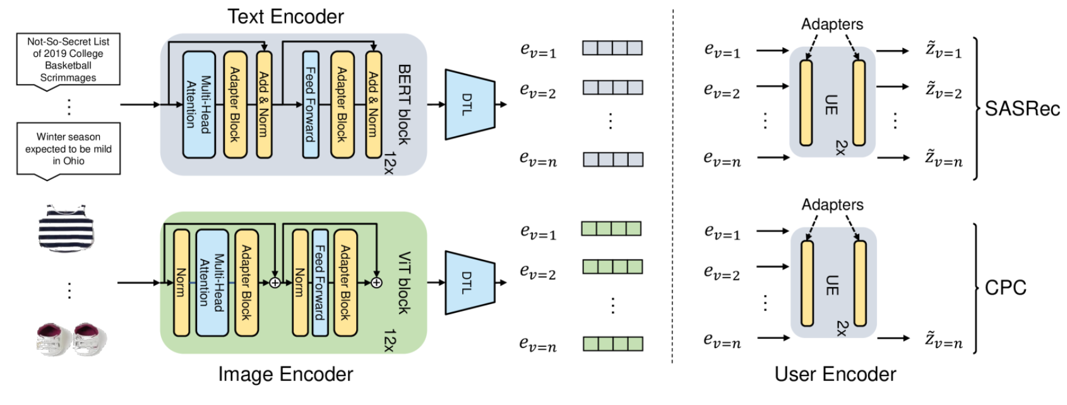
End-to-End Multimodal Recommendation
Adapter4Rec Architectures
[1] Fu, Junchen, et al. "Exploring adapter-based transfer learning for recommender systems: Empirical studies and practical insights." WSDM’24.
Notes:
On this slide, we zoom into the Adapter4Rec architecture.
The left side shows that pretrained modality encoders can be used for recommendation items. A text encoder, such as BERT, processes item text; an image encoder, such as ViT, processes item images. Instead of fully fine-tuning the whole encoder, small adapter blocks are inserted into the transformer layers, while most backbone parameters can remain fixed or only lightly updated.
After the modality encoders produce item representations, a lightweight transfer or projection layer maps them into the recommendation space. This produces embeddings that can be consumed by downstream sequential or user behavior models.
The right side shows that adapter modules can also be placed in the user encoder. The examples here connect the adapted item embeddings to representative recommendation architectures such as SASRec and CPC. This means the parameter-efficient idea is not restricted to the content encoder; it can also be applied inside the recommender itself.
The key point is that Adapter4Rec provides a practical bridge between foundation-model representations and recommender architectures. It keeps the benefit of pretrained text and image encoders, while reducing the amount of task-specific parameter updating required for each domain.

Slide 24
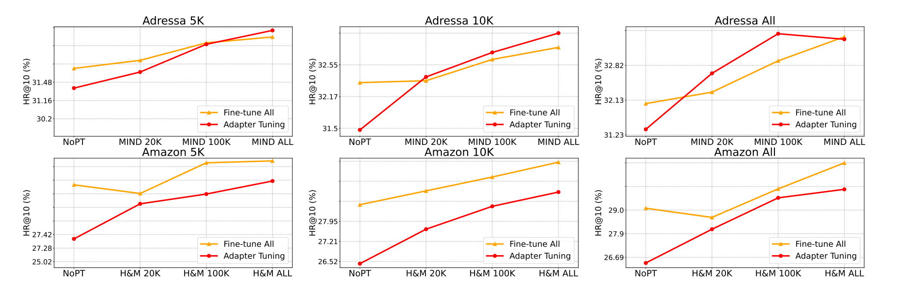
End-to-End Multimodal Recommendation
Scaling effect
[1] Fu, Junchen, et al. "Exploring adapter-based transfer learning for recommender systems: Empirical studies and practical insights." WSDM’24.
Notes:
On this slide, we discuss the scaling effect observed in Adapter4Rec.
The six plots compare recommendation performance under different amounts of pretraining or source-domain data. The x-axis increases the scale of the source data, while the y-axis reports HR@10. The two curves compare full fine-tuning with adapter tuning.
A key observation is that adapter tuning can benefit from larger pretraining data. When the source data is small, adapter tuning may start below full fine-tuning in some settings. As the source data grows, the adapter-based method often improves steadily and can become competitive with, or in some cases stronger than, full fine-tuning.
This result is important for transfer learning. It suggests that parameter-efficient adaptation is not only a way to save parameters; it can also provide a scalable way to reuse knowledge learned from larger recommendation domains or content-rich corpora.
The practical takeaway is that if we want recommendation systems to benefit from foundation models and large-scale pretraining, we should not only ask whether full fine-tuning works. We should also test whether adapter-based methods can capture the scaling benefit with lower adaptation cost and better transferability.

Slide 25
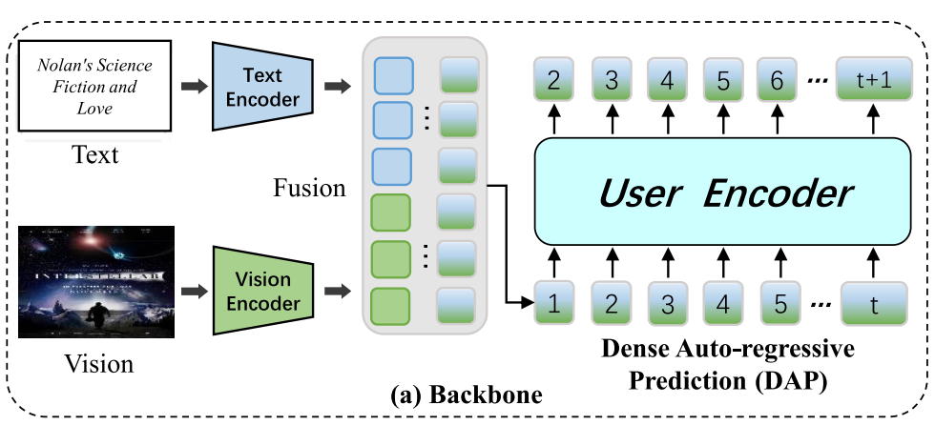
End-to-End Multimodal Recommendation
PMMRec: Exploration on Dual Encoder finetuning.
[1] Li, Youhua, et al. "Multi-modality is all you need for transferable recommender systems." ICDE’24.
Notes:
On this slide, we look at PMMRec from the paper 'Multi-modality is all you need for transferable recommender systems.'
This work pushes the modality-based idea further by asking whether recommendation can rely purely on multimodal item content, rather than item IDs.
The figure shows a backbone where text and vision information are encoded separately, fused into item representations, and then passed into a user encoder for dense auto-regressive prediction.
The important motivation is transferability. ID embeddings are tied to a specific item catalog, so they do not transfer easily across domains or platforms. Multimodal content, however, can describe new items even when interaction histories are missing.
PMMRec therefore learns transition patterns over content-based item representations. This can be useful for cross-domain recommendation and cold-start settings.
The takeaway is that multimodal foundation models open a path from catalog-specific ID modeling toward more transferable recommendation, but this also increases the need for effective modality fusion and efficient training.

Slide 26
End-to-End Multimodal Recommendation
Traditional Adaptation approaches typically adopt full fine-tuning for pre- trained modality encoders, which is costly in terms of GPU memory and training time.
To address this issue, methods like Adapter4Rec [1] utilize adapters or Low-Rank Adaptation (LoRA) techniques emphasizing parameter-efficiency for recommendation tasks, which all belongs to EPEFT in our research.
Notes:
On this slide, we introduce the efficiency problem that motivates decoupled parameter-efficient adaptation methods such as IISAN.
The left side represents full fine-tuning. In this setting, all or most parameters of the pretrained modality encoder are updated for the recommendation task. This can be effective, but it is expensive because training has to store activations for the whole backbone and backpropagate through every transformer layer. The cost becomes especially high when the modality encoder is large, for example a large BERT, ViT, or multimodal foundation model.
The right side represents embedded PEFT, or EPEFT. Methods such as adapters and LoRA update only a small number of additional parameters, so they are parameter-efficient. However, the PEFT modules are still embedded inside the backbone encoder. As a result, during training we usually still need to run the full encoder and keep intermediate hidden states for backpropagation.
This means EPEFT reduces the number of trainable parameters, but it does not completely solve GPU memory and training-time bottlenecks. In recommendation, this is a serious issue because we may need to encode a very large number of items and support repeated training across datasets or domains.
This slide sets up the next one: IISAN addresses the bottleneck by moving adaptation into side networks and decoupling it from the frozen foundation encoder, so hidden states can be cached and reused more efficiently.

Slide 27
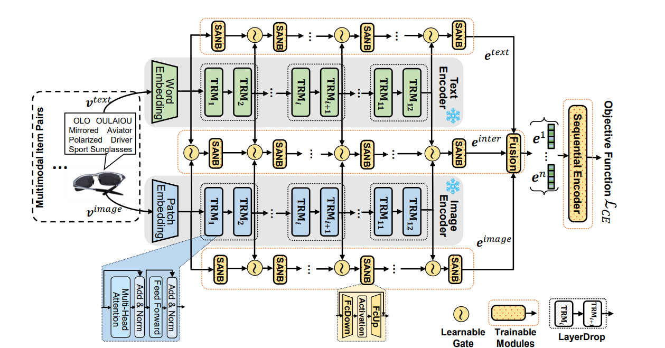
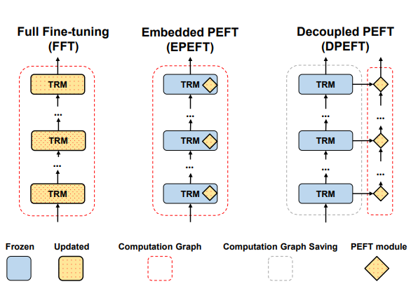
End-to-End Multimodal Recommendation
IISAN address this problem by using decoupled paradigm and intra- and inter-modal side adapter towers.
Fu, Junchen, et al. "IISAN: Efficiently adapting multimodal representation for sequential recommendation with decoupled PEFT." SIGIR’24.
Notes:
On this slide, we introduce IISAN, which is designed to adapt multimodal foundation models efficiently for sequential recommendation.
The left part compares three adaptation paradigms. Full fine-tuning updates the whole transformer, embedded PEFT inserts trainable modules inside the transformer computation graph, and decoupled PEFT separates the trainable module from the frozen backbone.
IISAN uses the decoupled paradigm. The main encoders are kept frozen, while side adapter towers are trained to adapt text and image representations for recommendation.
The right part shows the full IISAN architecture. It includes intra-modal adaptation, where each modality is adapted within itself, and inter-modal adaptation, where text and image representations interact through side adapter networks and fusion modules.
This design is plug-and-play: it can adapt pre-trained multimodal encoders to a sequential recommendation objective without updating the whole foundation model.
The main message is that IISAN is not only parameter-efficient. It is designed to be training-time and memory efficient, which is crucial when applying multimodal foundation models in realistic recommendation scenarios.

Slide 28
End-to-End Multimodal Recommendation
We identify that the hidden states can be cached for DPEFT more efficiency.
Notes:
On this slide, we focus on the caching advantage of decoupled PEFT in IISAN.
The figure compares embedded PEFT and decoupled PEFT. In embedded PEFT, the adapter is inside the transformer computation graph. When the adapter parameters are updated, the hidden states passing through later transformer blocks can change.
This means the model must repeatedly recompute the backbone hidden states during training, which is expensive for large encoders.
In decoupled PEFT, the frozen backbone produces stable hidden states. The trainable side module receives these hidden states, but its updates do not change the backbone outputs.
Therefore, the hidden states of the frozen encoder can be cached in advance. During training, the model can reuse cached representations instead of repeatedly forwarding through the entire foundation model.
This is a key efficiency insight: decoupling does not only reduce the number of trainable parameters; it also changes the computation graph in a way that enables large savings in training time and GPU memory.

Slide 29
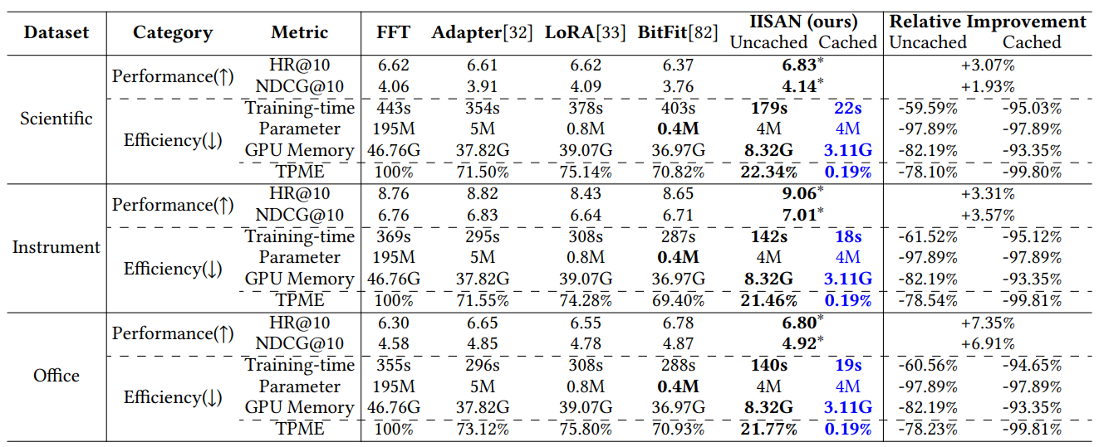
End-to-End Multimodal Recommendation
IISAN delivers superior performance while maintaining exceptional efficiency.
Notes:
On this slide, we look at the empirical results of IISAN.
The table compares full fine-tuning, Adapter, LoRA, BitFit, and IISAN across several datasets. The metrics include recommendation performance, such as HR@10 and NDCG@10, as well as efficiency metrics such as training time, number of trainable parameters, GPU memory, and TPME.
The important observation is that IISAN achieves strong recommendation performance while being much more efficient than full fine-tuning and many standard PEFT baselines.
The cached version is especially important. Because decoupled PEFT allows hidden states to be cached, training time and GPU memory can be dramatically reduced while maintaining competitive accuracy.
This table also supports a broader point: parameter efficiency alone is not enough. A method with few trainable parameters may still be slow or memory-heavy if it requires repeated backbone computation.
So the takeaway is that practical recommender-system adaptation should evaluate performance, trainable parameters, memory usage, and training time together.

Slide 30
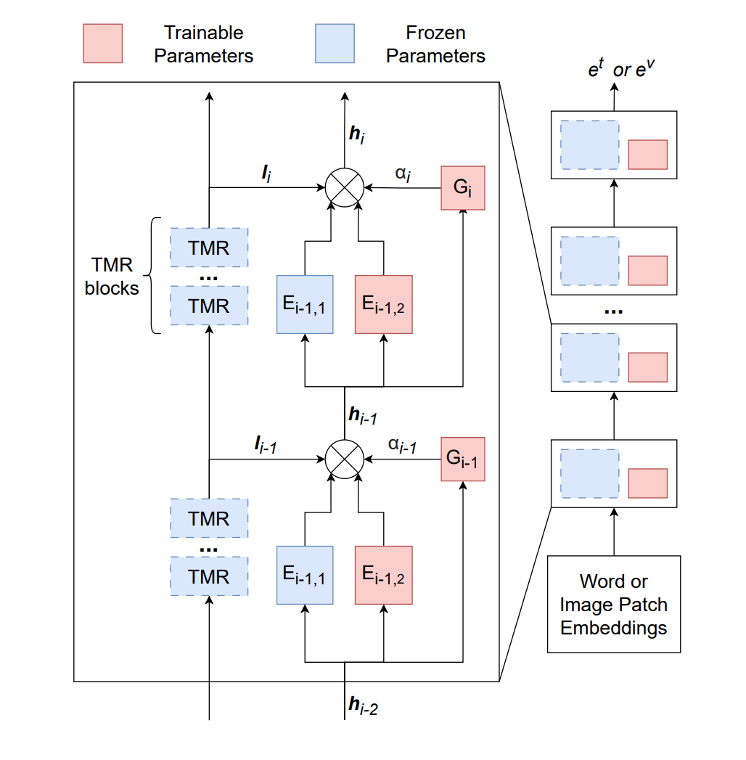
End-to-End Multimodal Recommendation
XSMoE is a follow-up work on IISAN paradigm
Qu, Yunke, et al. "Efficient multimodal streaming recommendation via expandable side mixture-of-experts.” CIKM’25.
Notes:
On this slide, we show a follow-up direction based on the IISAN-style side-adaptation paradigm: efficient multimodal streaming recommendation.
The referenced paper proposes XSMoE, an expandable side mixture-of-experts framework for streaming recommender systems.
Streaming recommendation is challenging because user interests can drift over time and new items continuously appear. Updating large multimodal encoders directly would be expensive and may cause forgetting of previous knowledge.
XSMoE keeps the pre-trained encoders frozen and attaches expandable side expert networks. As new feedback arrives, the model can expand experts to capture new modality-specific preference patterns.
A router or gating mechanism combines the frozen backbone output with expert outputs, while a pruning strategy removes underused experts to keep the model compact.
This slide shows that the side-adapter idea is not limited to static recommendation. It can also support continual and streaming settings where efficiency, adaptability, and forgetting are all important.

Slide 31
End-to-End Multimodal Recommendation
Although IISAN demonstrates state-of-the-art efficiency and effectiveness in adapting multimodal foundation models (MFMs) for recommendation tasks, it still faces two major limitations (Depth and Breadth) that restrict its broader applicability:
Depth Limitation: It relies on the assumption of symmetrical multimodal encoders, which does not hold in practice, as large language models (LLMs) are typically much deeper than vision encoders.
Breadth Limitation: It supports only two modalities, overlooking the fact that real-world recommendation scenarios often involve multiple modalities beyond just text and vision.
Notes:
On this slide, we discuss two limitations of the original IISAN framework.
First, there is a depth limitation. IISAN assumes a relatively symmetrical architecture between modalities. For example, it is easier to align a text encoder and an image encoder when they have comparable layer structures.
However, in modern foundation models, this assumption often breaks. Large language models can be much deeper than vision transformers, so layer-by-layer alignment becomes difficult.
Second, there is a breadth limitation. IISAN mainly focuses on two modalities, typically text and image. But real recommendation systems may also include video, audio, reviews, captions, metadata, and other signals.
These two limitations point to the next research challenge: we need adaptation methods that can handle asymmetric encoders and more than two modalities without losing the efficiency benefits of decoupled PEFT.
This slide therefore motivates IISAN-Versa and CROSSAN, which appear in the following slides.

Slide 32
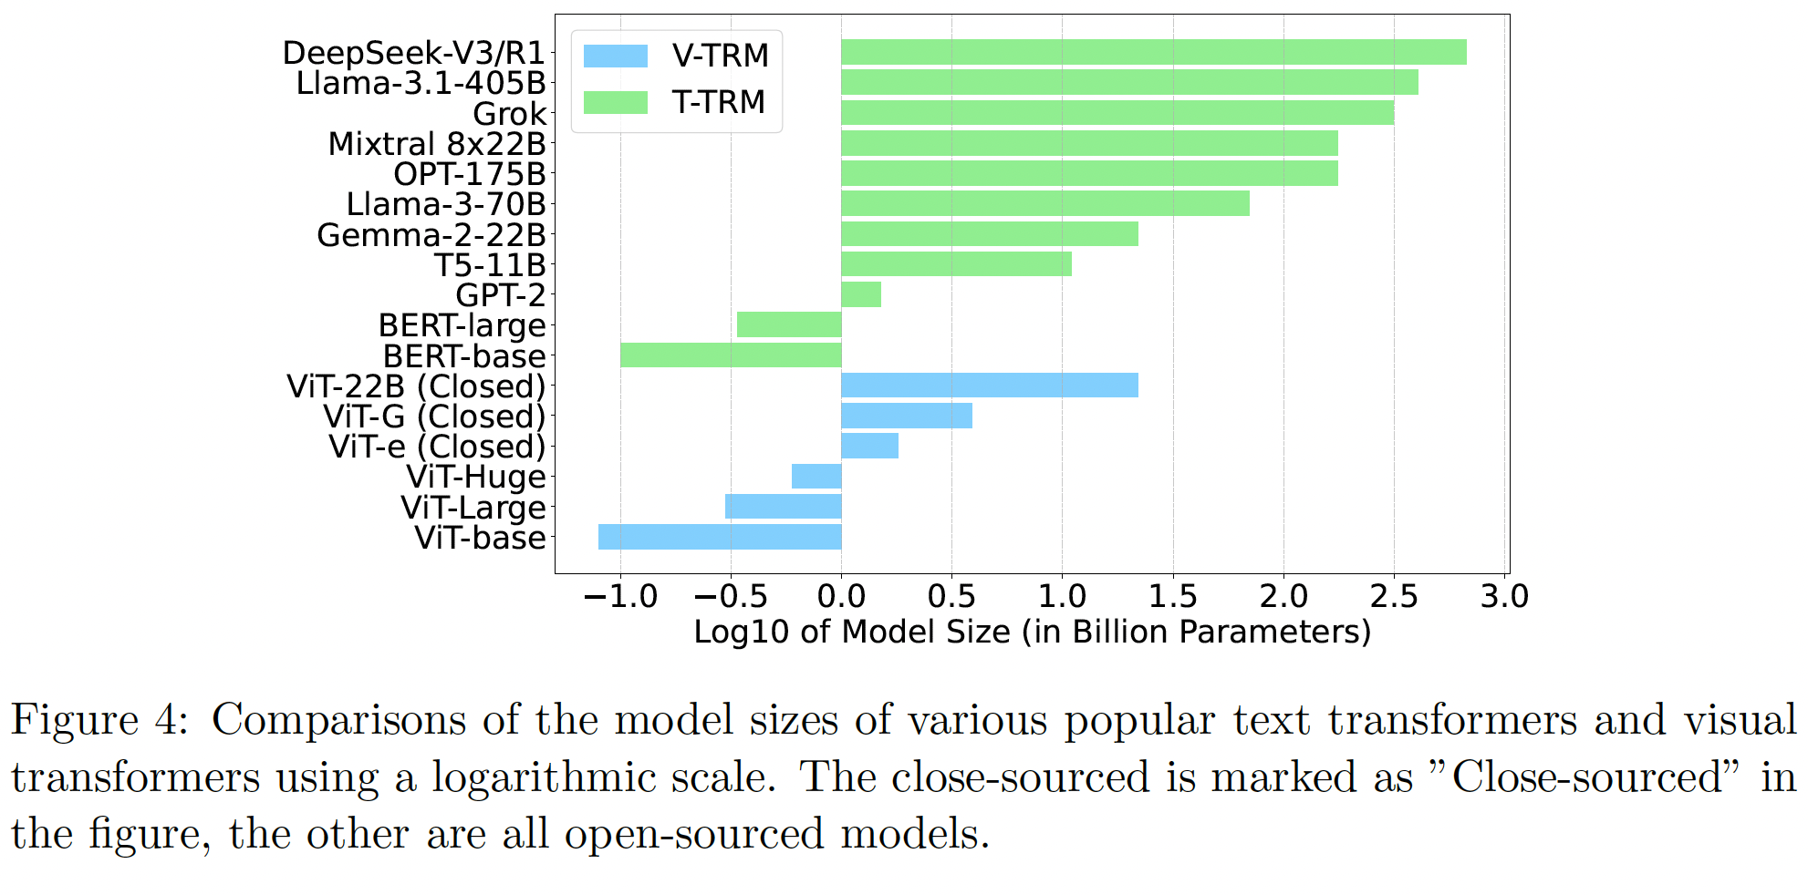
End-to-End Multimodal Recommendation
Text Transformers are typically much deeper than Visual Transformers, leading to structural asymmetry during adaptation.
Notes:
On this slide, we visualize the depth and scale asymmetry between text transformers and vision transformers.
The chart compares popular text and visual transformer models on a logarithmic parameter scale. Text models, especially modern LLMs, can reach billions or even hundreds of billions of parameters.
In contrast, many visual transformers used as image encoders are much smaller. Even large ViT variants are typically far below the scale of the largest text models.
This asymmetry matters for multimodal adaptation. If we try to align layers between a deep text encoder and a shallower vision encoder directly, there may be no clean one-to-one correspondence.
For recommendation, this creates a practical design problem. We want to use large text encoders because product titles, descriptions, and reviews are highly informative, but we also need a way to combine them with image encoders efficiently.
The takeaway is that future multimodal recommendation methods must be robust to structural asymmetry rather than assuming all encoders have similar depth and size.

Slide 33
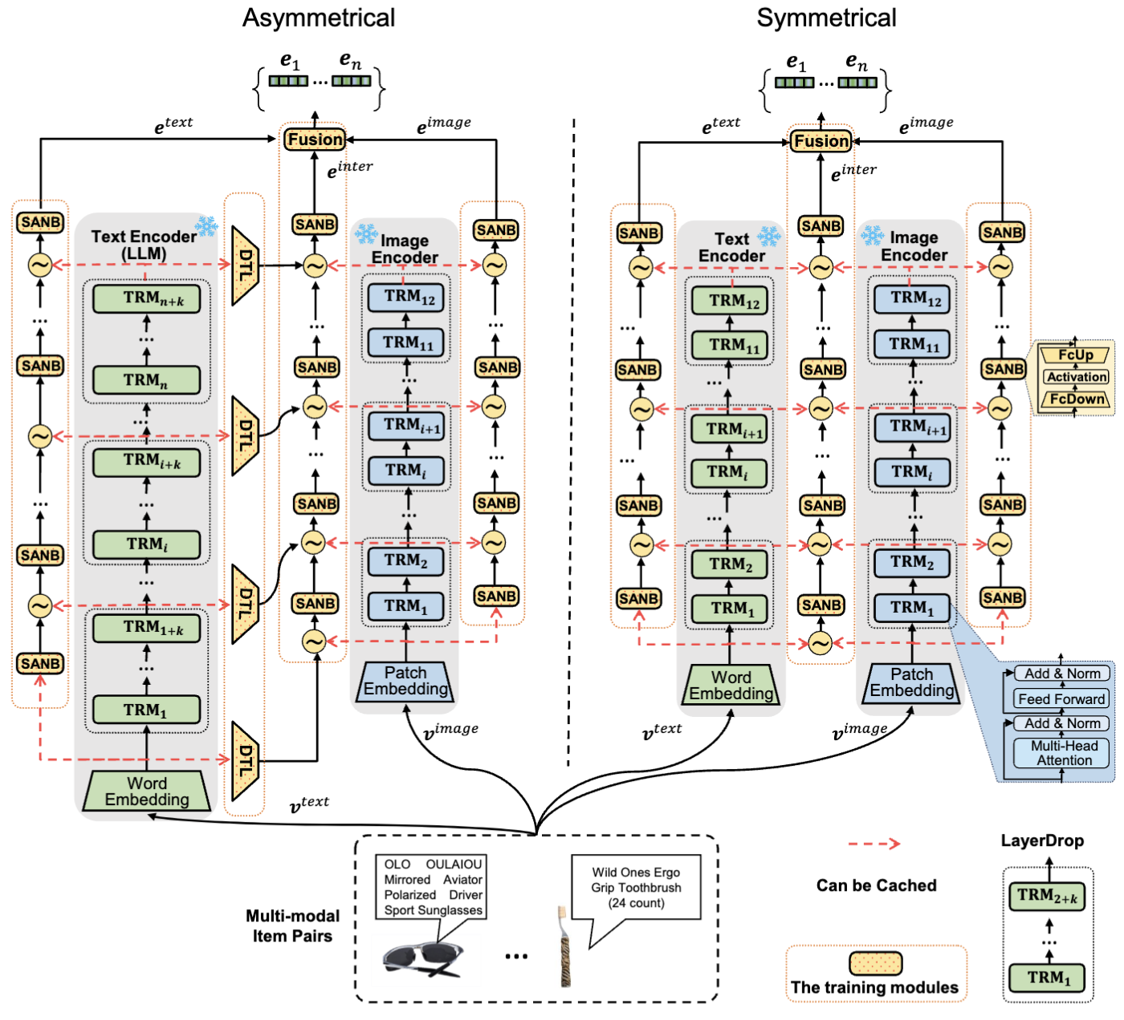
End-to-End Multimodal Recommendation
We propose “IISAN-Versa” Handles asymmetrical structures by intuitive approach using simple dimension transformation layers and group layer dropping.
Fu, Junchen, et al. "Efficient and effective adaptation of multimodal foundation models in sequential recommendation.” IEEE TKDE’25
Notes:
On this slide, we introduce IISAN-Versa as a response to the asymmetry problem.
The figure compares asymmetrical and symmetrical encoder settings. In the asymmetrical case, the text encoder may be much deeper than the image encoder, so direct layer-by-layer adaptation is not straightforward.
IISAN-Versa handles this with two simple mechanisms. The first is dimension transformation, which aligns representation spaces when different encoders output features of different sizes.
The second is group layer dropping. Instead of forcing every layer to participate, the model groups layers and selectively aligns or drops layers to create a more manageable adaptation structure.
This allows the method to keep the advantages of decoupled side adaptation while becoming compatible with larger and more diverse text encoders.
The main takeaway is that efficient multimodal adaptation must deal not only with the number of parameters, but also with architectural mismatch across modalities.

Slide 34
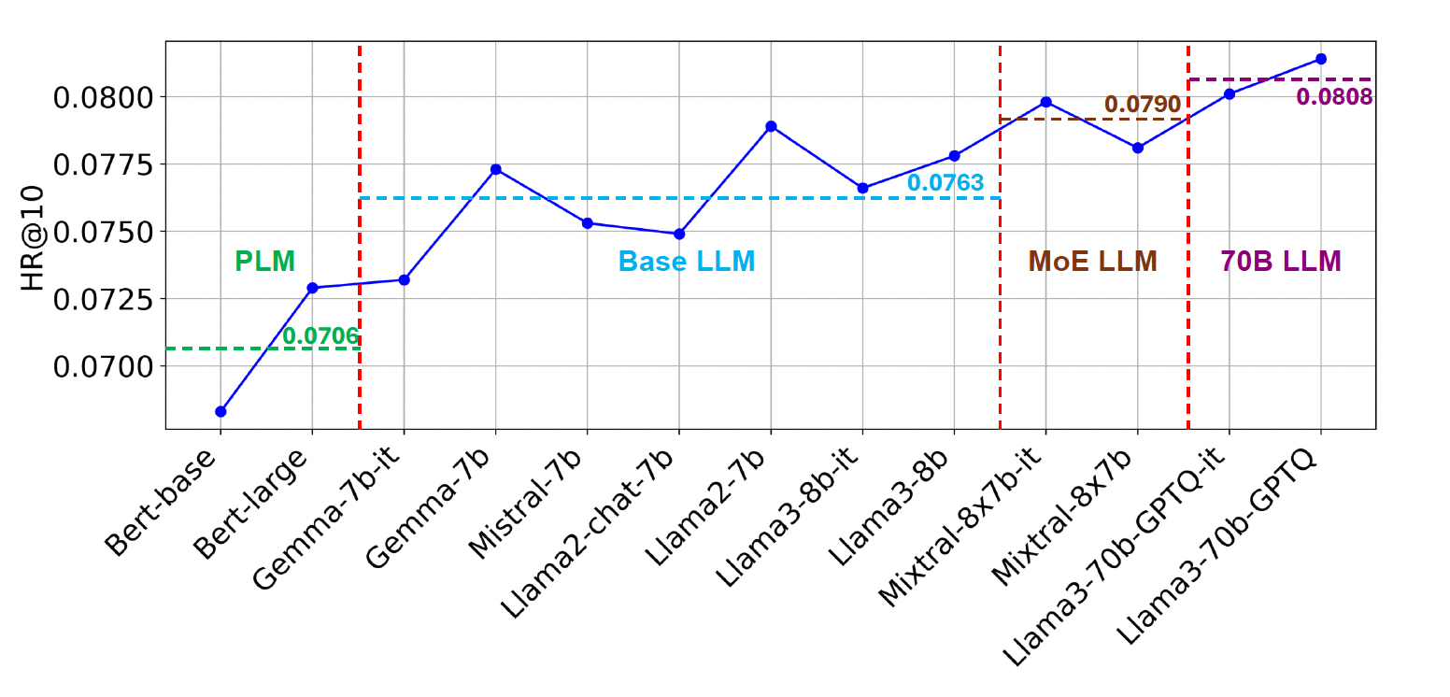
End-to-End Multimodal Recommendation
IISAN-Versa can incorporate larger LLMs as encoders and demonstrates a scaling effect as the model size increases.
Notes:
On this slide, we examine the scaling effect observed in IISAN-Versa.
The plot shows recommendation performance, measured by HR@10, when different text encoders are used, ranging from BERT models to base LLMs, mixture-of-experts LLMs, and larger 70B-level LLMs.
The general trend suggests that larger language models can provide stronger item representations for recommendation, especially when textual item information is informative.
This is important because it connects recommender systems to the broader scaling behavior seen in NLP and foundation-model research.
However, the slide should also be interpreted carefully. Larger models usually bring higher computation, storage, and deployment costs. Therefore, the value of IISAN-Versa is not simply that it uses larger models, but that it provides a practical adaptation mechanism for using them more efficiently.
The takeaway is that scaling can improve multimodal recommendation, but scaling must be paired with efficient adaptation and caching to be usable in real recommender systems.

Slide 35
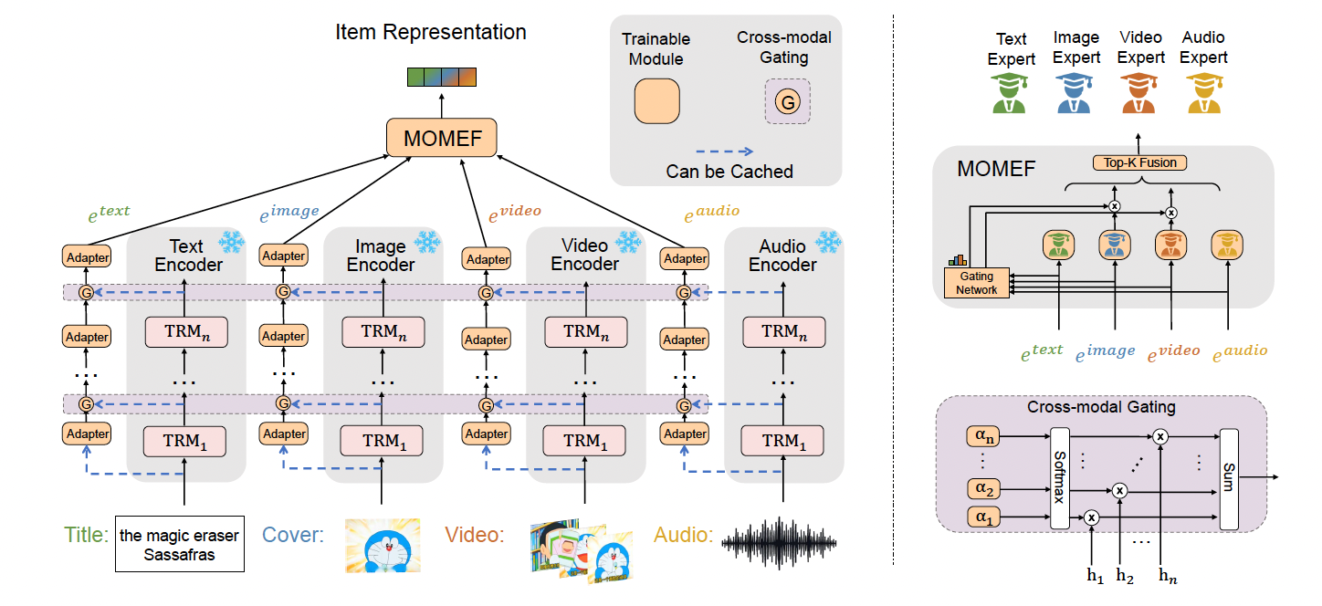
End-to-End Multimodal Recommendation
CROSSAN for more modalities.
Fu, Junchen, et al. "Crossan: Towards efficient and effective adaptation of multiple multimodal foundation models for sequential recommendation." arXiv’25.
Notes:
On this slide, we introduce CROSSAN, which extends efficient adaptation from two modalities to multiple multimodal foundation models.
The motivation is that real recommendation systems may contain text, image, video, audio, and other raw modality signals. Adapting one or two encoders is not enough for many practical applications.
CROSSAN uses a cross-modal side adapter network. The foundation encoders are kept frozen, while trainable side modules and cross-modal gating mechanisms allow information to flow across modalities.
The right side of the figure shows MOMEF, the Mixture of Modality Expert Fusion mechanism. Instead of simply concatenating all modality embeddings, it uses modality experts and gating to select and combine useful modality information.
This design aims to be scalable. Because the main encoders are frozen and the side modules can be cached or trained efficiently, the method can adapt more than two multimodal foundation models.
The takeaway is that CROSSAN moves the field from bimodal adaptation toward multi-foundation-model adaptation, which is closer to real-world multimodal recommendation.

Slide 36
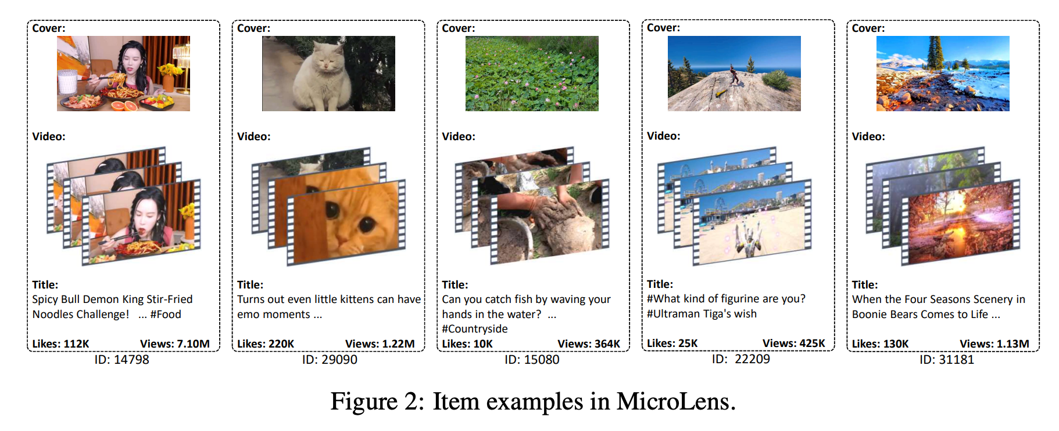
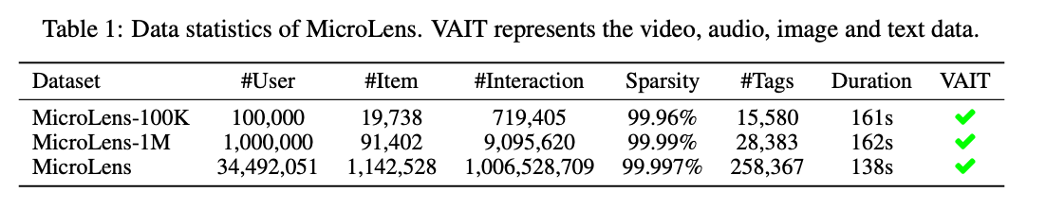
End-to-End Multimodal Recommendation
MicroLens Dataset of four modalities (Text, Image, Audio, and Videos)
https://github.com/westlake-repl/MicroLens
Ni Y, Cheng Y, Liu X, Fu J, Li Y, He X, Zhang Y, Yuan F. A content-driven micro-video recommendation dataset at scale. CIKM’25
Notes:
On this slide, we introduce MicroLens, a large-scale micro-video recommendation dataset designed for content-driven and multimodal recommendation research.
The key feature of MicroLens is that each item is associated with four modalities: video, audio, image, and text, summarized as VAIT. The examples in the figure show that a micro-video item may include a cover image, video frames, a title, popularity signals such as likes and views, and an item ID.
This is important because micro-video recommendation is naturally multimodal. Users react not only to the textual title, but also to visual content, audio cues, video dynamics, and social feedback. A benchmark with these signals makes it possible to test whether a model can really use multiple modalities instead of relying only on IDs or text.
The table highlights the scale of the dataset. It includes smaller versions such as MicroLens-100K and MicroLens-1M, as well as a much larger version with tens of millions of users, more than one million items, and over one billion interactions. The sparsity is very high, which reflects the real challenge of recommendation at web scale.
For this lecture, MicroLens is useful because it provides a realistic testbed for end-to-end multimodal recommendation. Methods such as IISAN, IISAN-Versa, and CROSSAN need datasets like this to evaluate whether efficient adaptation can work when text, image, audio, and video content are all available.

Slide 37
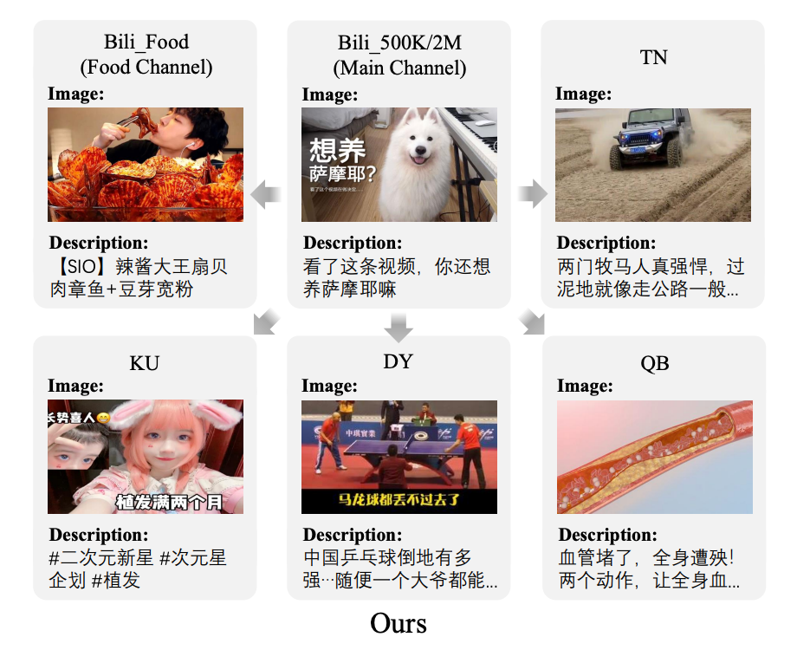
End-to-End Multimodal Recommendation
NineRec Dataset for Transfer learning scenario for end-to-end multimodal recommendation.
https://github.com/westlake-repl/NineRec
Zhang J, Cheng Y, Ni Y, Pan Y, Yuan Z, Fu J, Li Y, Wang J, Yuan F. Ninerec: A benchmark dataset suite for evaluating transferable recommendation. IEEE TPAMI’24
Notes:
On this slide, we introduce NineRec, a benchmark dataset suite for transferable recommendation.
The motivation is that real recommender systems often need to transfer knowledge across domains, platforms, or content channels. A model trained on one domain may need to adapt to another domain where user behavior, item style, item text, and visual content are different.
The figure illustrates several domains or channels, such as food, general video content, news-like or short-video platforms, and other application areas. Each item example contains multimodal content, typically an image or cover frame together with a textual description. The arrows emphasize that the benchmark is not only about training within one dataset, but also about evaluating transfer across datasets.
NineRec is therefore useful for studying whether end-to-end multimodal recommendation models learn representations that generalize. If a method only performs well on a single domain, it may be overfitting to local item IDs or domain-specific interaction patterns. A transferable benchmark asks whether content representations and adaptation modules can move knowledge from source domains to target domains.
The takeaway is that datasets such as NineRec push the field beyond static accuracy on one dataset. They help evaluate transferability, domain adaptation, and the practical value of multimodal foundation models in recommendation scenarios where domains continuously change.

Slide 38
Conclusions and Key takeaways
Key Points
The field is moving from fixed feature extraction to end-to-end foundation model adaptation.
Full fine-tuning can improve performance but is expensive.
IISAN with Decoupled side adapters, and caching make adaptation more practical.
IISAN-Versa handle larger LLMs, asymmetric encoders, and CROSSAN for multiple modalities.
Notes:
This section focuses on the shift from using fixed multimodal embeddings to adapting foundation models directly for recommendation. Full fine-tuning can improve recommendation performance, but it is often costly in training time, GPU memory, and computation. To make end-to-end adaptation more practical, recent methods use decoupled side adapters and cached hidden states, which reduce the need to repeatedly update or recompute large backbone models. IISAN-Versa further extends this direction by handling larger LLMs and asymmetric text-vision encoders, while CROSSAN broadens the framework to multiple modalities. The main takeaway is that end-to-end multimodal recommendation is becoming more scalable through efficient and flexible adaptation strategies.

Slide 39
Table of Content
Background
Multimodal Features as Auxiliary Signals
Multimodal Content-only Recommendation
Multimodal Generative Recommendation
Conclusion and Key Takeaways
Notes:
This slide marks the transition from end-to-end multimodal recommendation to multimodal generative recommendation.
So far, most methods we discussed still produce item representations and then score candidate items through a ranking or retrieval objective.
Generative recommendation changes the formulation. Instead of only scoring item embeddings, the model can generate an item identifier, a semantic ID, or a sequence of discrete tokens that represents the target item.
This is closely related to the rise of sequence-to-sequence models and large language models. It asks whether recommendation can be framed as a generation problem rather than only as a matching problem.
In this section, we will look at several representative methods that use semantic IDs, multimodal tokenization, and LLM-based generation for sequential and multimodal recommendation.
The main question is how multimodal content can help construct meaningful item tokens and improve generative retrieval.

Slide 40
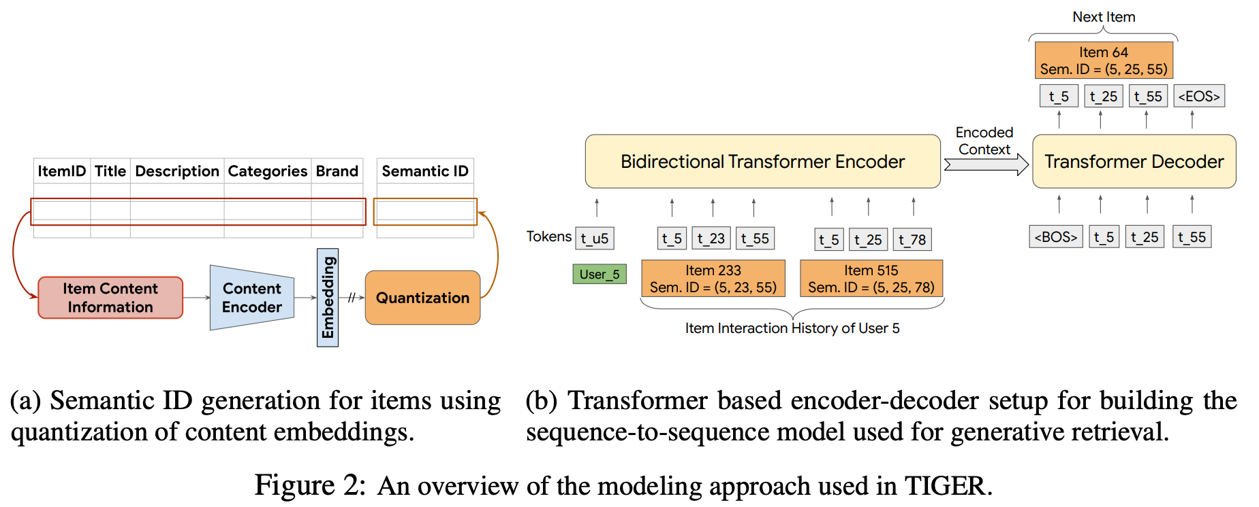
Multimodal Generative Recommendation
[1] Rajput, Shashank, et al. "Recommender systems with generative retrieval." NeurIPS’23
Notes:
On this slide, we introduce TIGER from the paper 'Recommender Systems with Generative Retrieval.'
Traditional retrieval usually represents users and items as vectors and uses nearest-neighbor search to find candidate items. TIGER proposes a different paradigm: generate the identifier of the target item autoregressively.
The left side shows semantic ID generation. Item content information is encoded into embeddings, and quantization converts those embeddings into a tuple of discrete semantic tokens.
The right side shows the sequence-to-sequence framework. Given a user's interaction history represented by semantic IDs, a Transformer encoder-decoder predicts the semantic ID of the next item.
This means the model can retrieve by generation. It produces tokens corresponding to candidate items, rather than searching through all item vectors with an external index.
The key contribution is that semantically meaningful item IDs can improve generalization, especially for new or less frequent items. This slide sets the foundation for later multimodal generative methods.

Slide 41
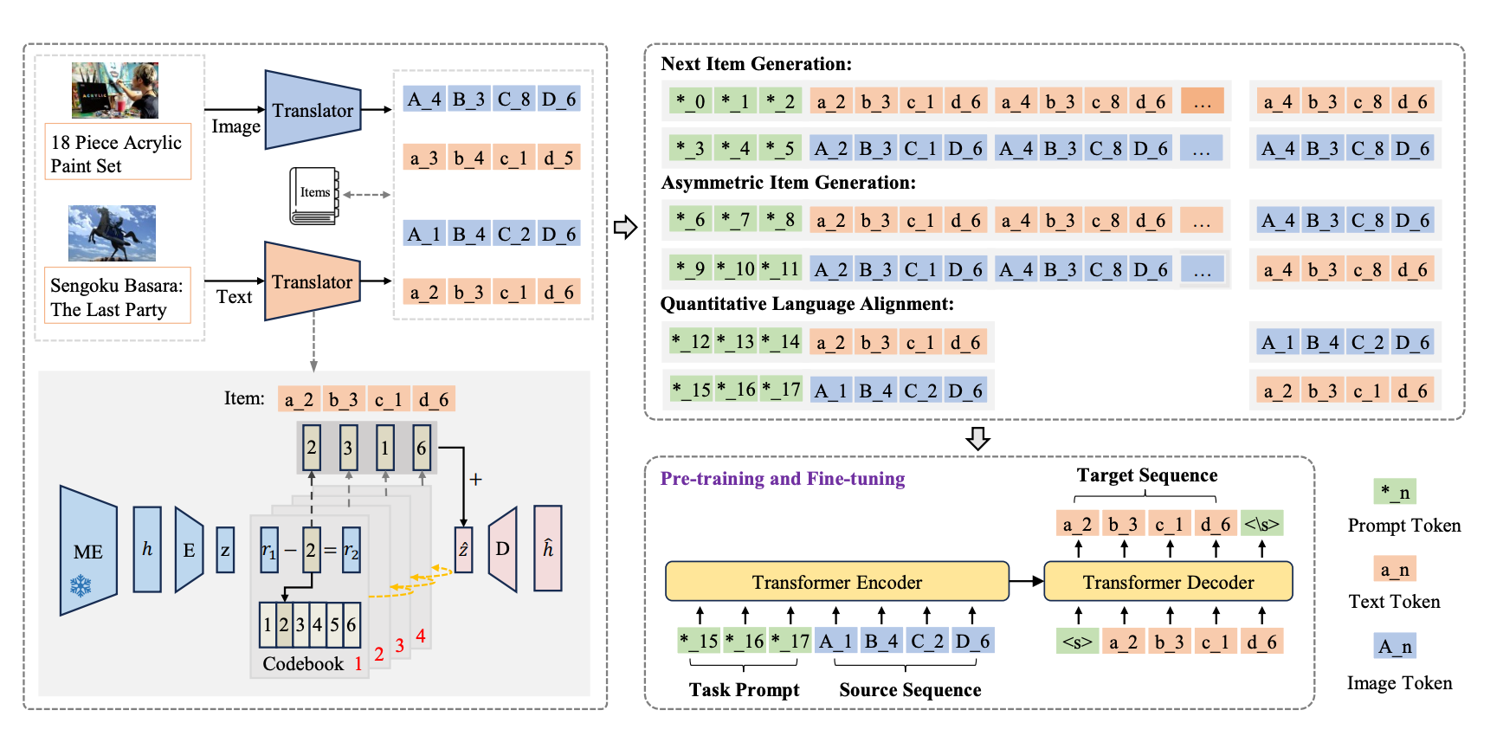
Multimodal Generative Recommendation
[1] Zhai, Jianyang, et al. "Multimodal quantitative language for generative recommendation." ICLR’25.
Notes:
On this slide, we introduce MQL4GRec, or Multimodal Quantitative Language for Generative Recommendation.
The paper argues that generative recommendation needs a language that can represent item content across modalities and domains. Natural language alone may not match the specific needs of recommendation, while raw item IDs are not semantically meaningful.
MQL4GRec therefore converts multimodal item content into a unified quantitative language. The figure shows image and text translators that turn item content into discrete tokens shared across items and domains.
The method then designs several generation tasks, such as next-item generation, asymmetric item generation, and quantitative language alignment. These tasks enrich the quantitative tokens with semantic and recommendation knowledge.
The bottom part shows pre-training and fine-tuning with a Transformer encoder-decoder, where prompts and multimodal quantitative tokens are used to guide recommendation generation.
The takeaway is that multimodal generative recommendation depends heavily on how we tokenize items. Better item languages can transfer knowledge across modalities, domains, and recommendation tasks.

Slide 42
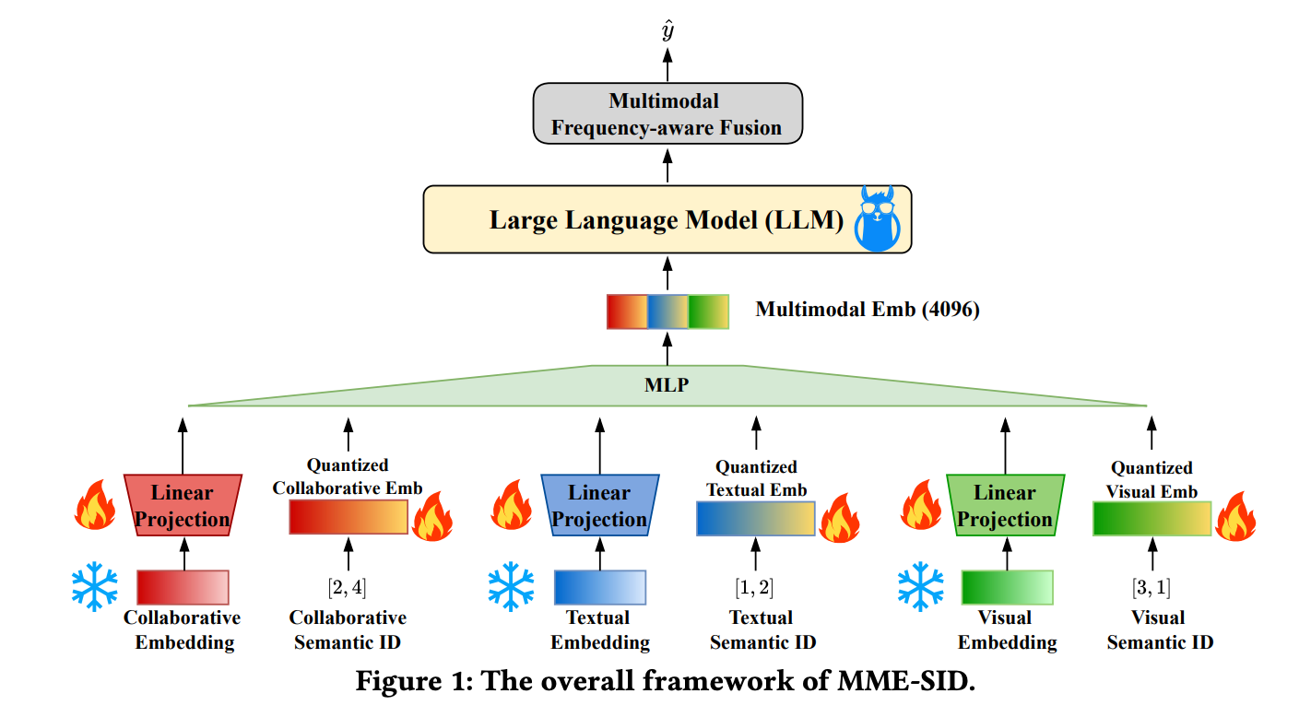
Multimodal Generative Recommendation
[1] Wang, Yuhao, et al. "Empowering large language model for sequential recommendation via multimodal embeddings and semantic ids." CIKM’25.
Notes:
On this slide, we introduce MME-SID, which uses multimodal embeddings and semantic IDs to empower LLM-based sequential recommendation.
The paper identifies two problems in existing LLM-based recommendation: embedding collapse when collaborative embeddings are incorporated, and catastrophic forgetting when quantized semantic IDs are used.
The framework combines collaborative, textual, and visual embeddings. Each modality is projected and quantized into semantic IDs, and the resulting quantized embeddings are fused before being passed into a large language model.
A key component is multimodal frequency-aware fusion, which helps the model combine modalities according to their usefulness and frequency characteristics.
The paper also uses a multimodal residual quantized variational autoencoder to preserve distance information and align cross-modal representations.
The main takeaway is that semantic IDs are powerful, but they must be constructed and integrated carefully. Multimodal information can help stabilize LLM-based sequential recommendation and improve the quality of generated recommendations.

Slide 43
Table of Content
Background
Multimodal Features as Auxiliary Signals
Multimodal Content-only Recommendation
Multimodal Generative Recommendation
Conclusions and Key Takeaways
Notes:
This slide marks the transition to the conclusion section.
We have now covered three major stages of multimodal recommendation research.
First, multimodal features are used as auxiliary signals. In this stage, visual, textual, audio, or video embeddings are injected into recommender models through fusion or graph construction.
Second, foundation models are adapted end-to-end for recommendation. This introduces stronger representation learning, but also requires efficient adaptation methods such as adapters, decoupled PEFT, IISAN, IISAN-Versa, and CROSSAN.
Third, generative recommendation reframes retrieval as token generation, where semantic IDs and multimodal item languages become central.
The conclusion slide will summarize the main lessons from these three stages and point to the practical challenges that remain.

Slide 44
Conclusions and Key takeaways
Multimodal recommendation is shifting from auxiliary feature fusion to end-to-end modeling
Efficient adaptation methods make large multimodal models practical for end-to-end adaptation for recommendation
Real-world systems require handling asymmetric encoders, multiple modalities, and scalable inference.
Generative recommendation offers a new retrieval paradigm based on semantic and multimodal item representations.
Notes:
On this slide, we summarize the main takeaways of the lecture.
The first takeaway is that multimodal recommendation is shifting from feature fusion to foundation-model-driven modeling. Earlier methods mainly used extracted multimodal embeddings as side information, while recent methods adapt large encoders more directly for recommendation objectives.
The second takeaway is that efficient adaptation is essential. Full fine-tuning of large multimodal models is often too expensive, so methods such as adapters, decoupled PEFT, caching, and side networks are important for practical systems.
The third takeaway is that real-world recommendation requires more flexible multimodal modeling. Systems must handle asymmetric encoders, multiple modalities, changing user interests, and scalable inference.
The fourth takeaway is that generative recommendation opens a new retrieval paradigm. Instead of only matching vectors, models can generate semantic or multimodal item identifiers.
Overall, foundation models give recommendation systems richer item understanding, but the core challenge is adapting and deploying them efficiently and reliably.

Slide 45


Thanks for your attention!
Q&A
Notes:
This is the closing slide of the talk.
At this point, the audience should have a high-level understanding of how multimodal recommendation has evolved from auxiliary feature fusion to foundation-model adaptation and generative retrieval.
A useful way to open the discussion is to ask what trade-off matters most in real systems: recommendation accuracy, training efficiency, inference latency, cold-start performance, interpretability, or transferability.
Another possible discussion point is modality usefulness. As we saw in the reproducibility study, more modalities do not automatically mean better recommendation, so future work should evaluate which modality contributes under which condition.
Questions are welcome, especially on the role of foundation models, efficient adaptation, multimodal fusion, and semantic IDs in next-generation recommender systems.

