Slide 1



Advancing Efficient and Effective Adaptation of Multimodal Foundation Models for Recommendation
Student: Junchen Fu
PhD Student – University of Glasgow
Visiting Student – Leiden University
DIR2025
October 27th 2025

Slide 2

Table of Contents
1. Background
2. IISAN (SIGIR2024)
3. IISAN-Versa: Depth Perspective (TKDE)
4. CROSSAN: Breadth Perspective (Preprint)

Slide 3
Background-Adapting Foundational Models
Traditional Adaptation approaches typically adopt full fine-tuning for pre- trained modality encoders, which is costly in terms of GPU memory and training time.
To address this issue, methods like Adapter4Rec [1] utilize adapters or Low-Rank Adaptation (LoRA) techniques emphasizing parameter-efficiency for recommendation tasks, which all belongs to EPEFT in our research.
[1] Junchen Fu, et al. "Exploring adapter-based transfer learning for recommender systems: Empirical studies and practical insights." Proceedings of the 17th ACM International Conference on Web Search and Data Mining. 2024.

Slide 4
Presented Work
Junchen Fu, Xuri Ge, Xin Xin, Alexandros Karatzoglou, Ioannis Arapakis, Jie Wang, Joemon M. Jose. IISAN: Efficiently Adapting Multimodal Representation for Sequential Recommendation with Decoupled PEFT - SIGIR'2024
Junchen Fu, Xuri Ge, Xin Xin, Alexandros Karatzoglou, Ioannis Arapakis, Kaiwen Zheng, Yongxin Ni, and Joemon M. Jose Efficient and Effective Adaptation of Multimodal Foundation Models in Sequential Recommendation. - IEEE TKDE2025
Junchen Fu, Yongxin Ni, Joemon M. Jose, Ioannis Arapakis, Kaiwen Zheng, Youhua Li, and Xuri Ge. CROSSAN: Towards Efficient and Effective Adaptation of Multiple Multimodal Foundation Models for Sequential Recommendation.
- Preprint (Under Review)

Slide 5
Table of Contents
1. Background
2. IISAN (SIGIR2024)
3. IISAN-Versa: Depth Perspective (TKDE)
4. CROSSAN: Breadth Perspective (Preprint)

Slide 6
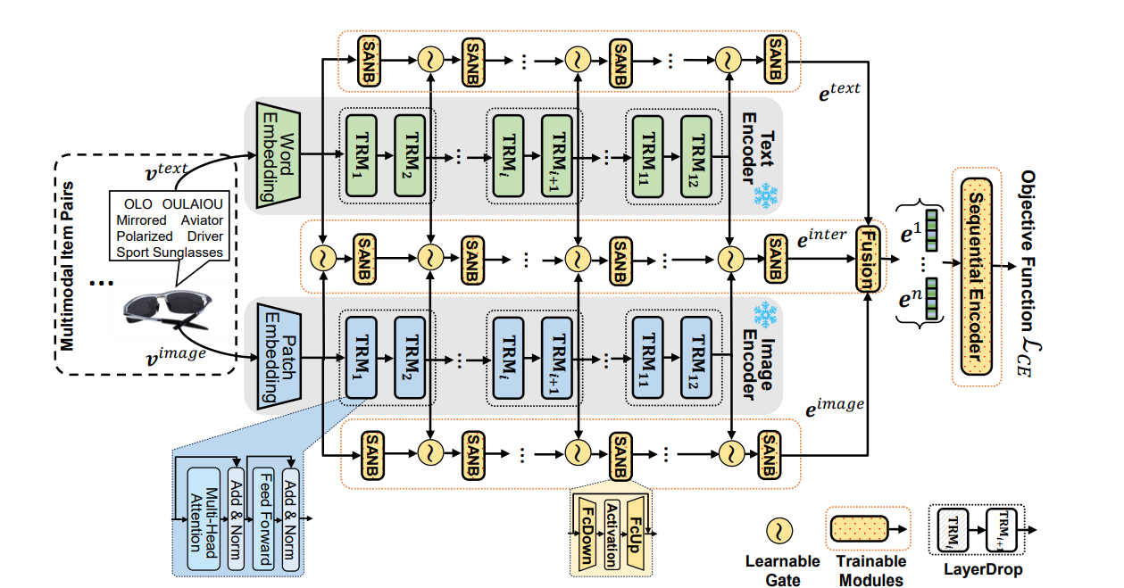
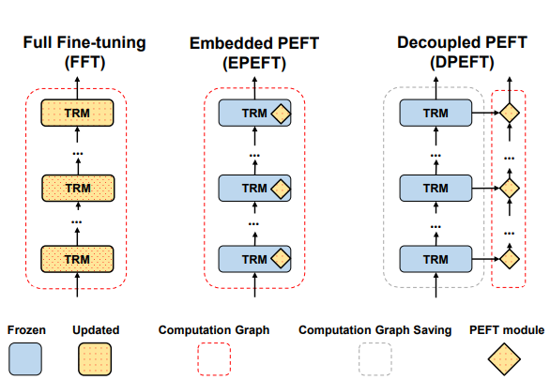
IISAN (SIGIR’24)
IISAN address this problem by using decoupled paradigm and intra- and inter-modal side adapter towers.

Slide 7
IISAN (SIGIR’24) - Caching Strategy
We identify that the hidden states can be cached for DPEFT more efficiency.

Slide 8
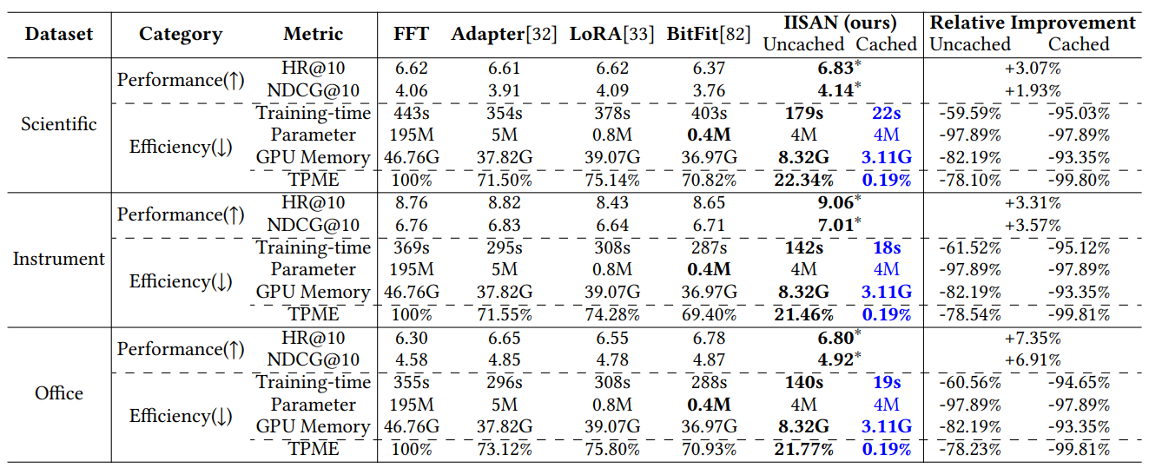
IISAN (SIGIR’24)
IISAN delivers superior performance while maintaining exceptional efficiency.

Slide 9
IISAN’s Limitations
Although IISAN demonstrates state-of-the-art efficiency and effectiveness in adapting multimodal foundation models (MFMs) for recommendation tasks, it still faces two major limitations (Depth and Breadth) that restrict its broader applicability:
Depth Limitation: It relies on the assumption of symmetrical multimodal encoders, which does not hold in practice, as large language models (LLMs) are typically much deeper than vision encoders.
Breadth Limitation: It supports only two modalities, overlooking the fact that real-world recommendation scenarios often involve multiple modalities beyond just text and vision.

Slide 10
Table of Contents
1. Background
2. IISAN (SIGIR2024)
3. IISAN-Versa: Depth Perspective (TKDE)
4. CROSSAN: Breadth Perspective (Preprint)

Slide 11
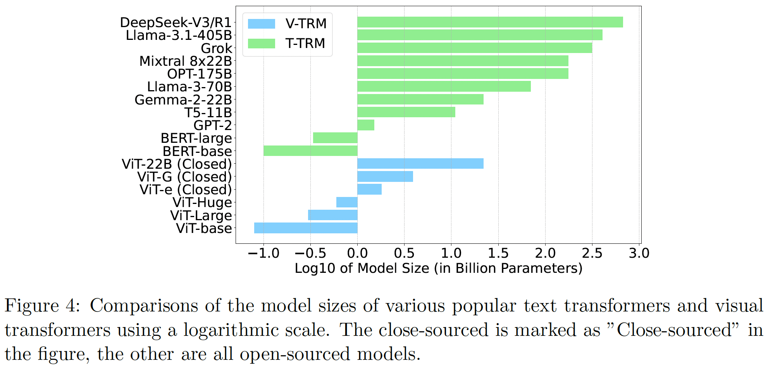
IISAN-Versa: Depth Perspective (Motivation)
Text Transformers are typically much deeper than Visual Transformers, leading to structural asymmetry during adaptation.

Slide 12
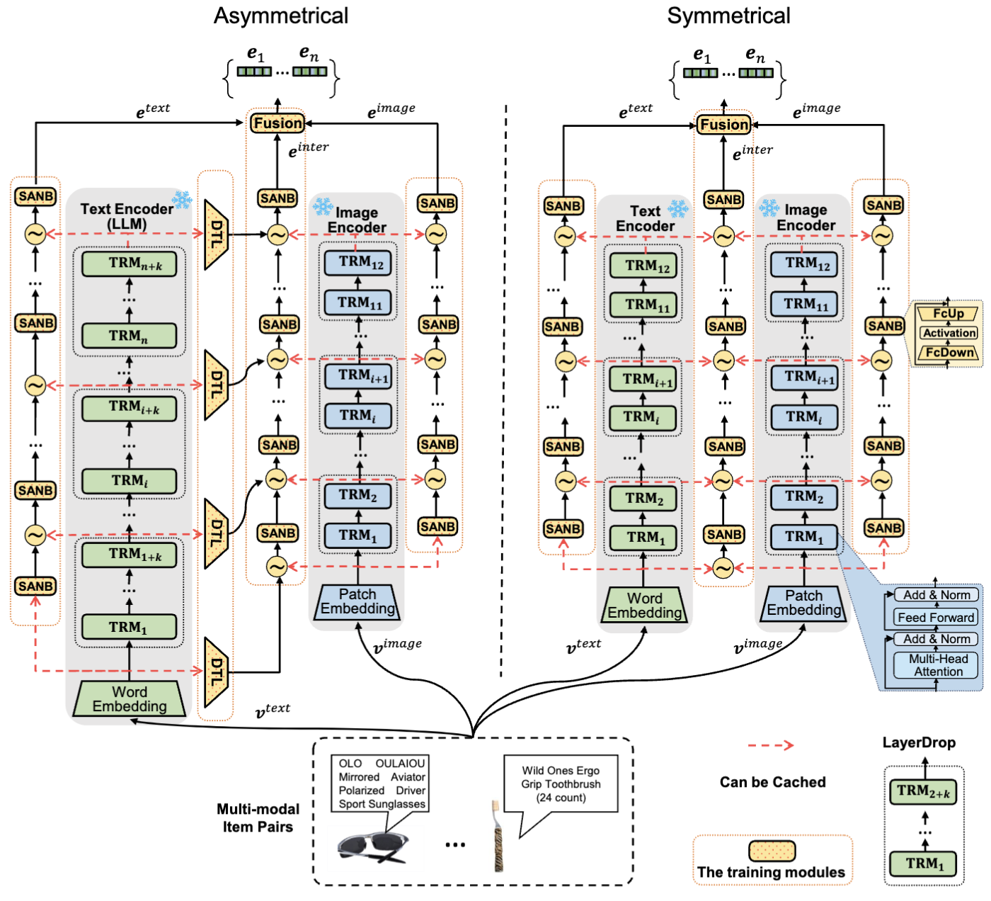
IISAN-Versa: Depth Perspective (TKDE)
We propose “IISAN-Versa” Handles asymmetrical structures by intuitive approach using simple dimension transformation layers and group layer dropping.

Slide 13
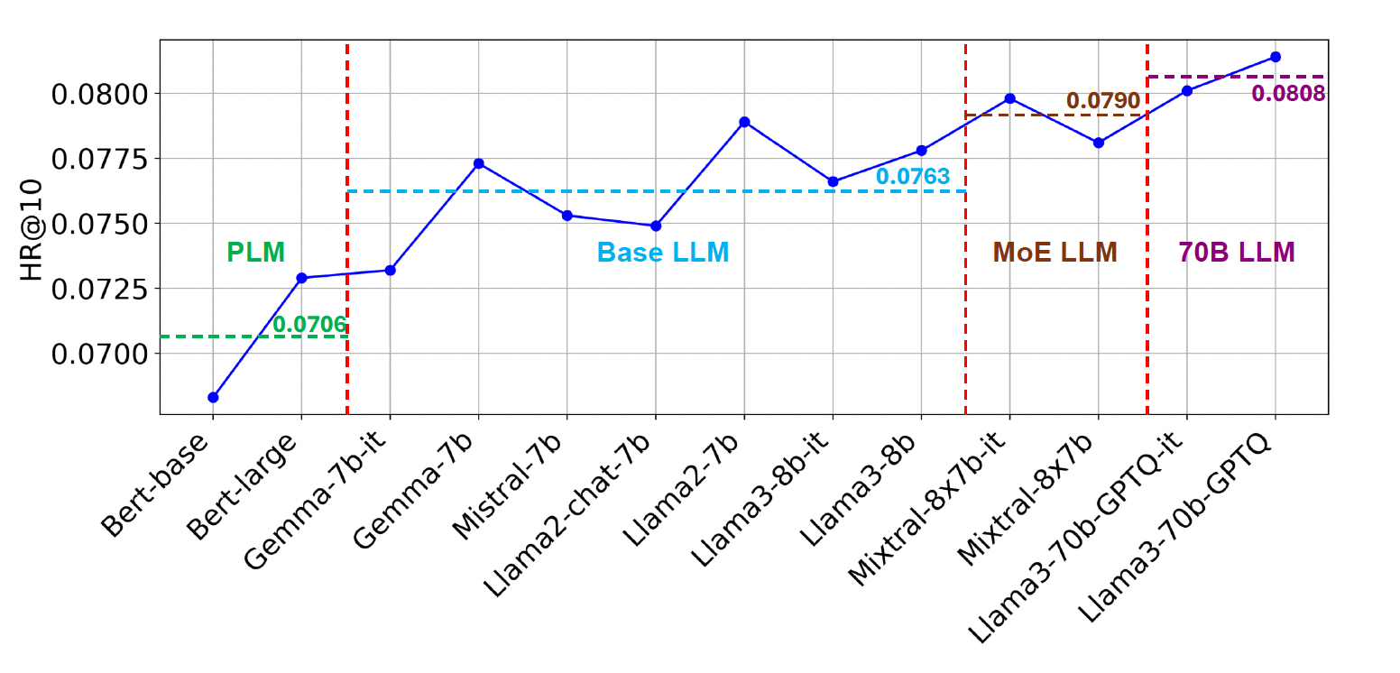
IISAN-Versa: Depth Perspective (TKDE)
IISAN-Versa can incorporate larger LLMs as encoders and demonstrates a scaling effect as the model size increases.

Slide 14
Table of Contents
1. Background
2. IISAN (SIGIR2024)
3. IISAN-Versa: Depth Perspective (TKDE)
4. CROSSAN: Breadth Perspective (Preprint)

Slide 15
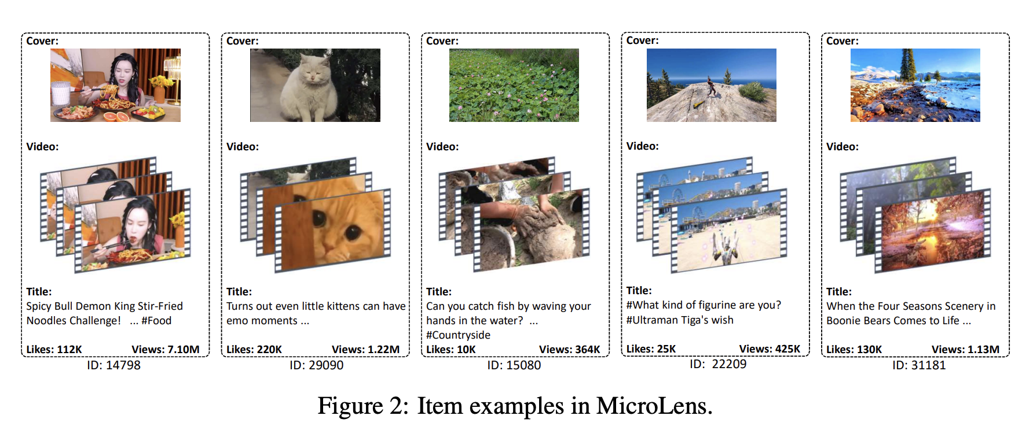
CROSSAN: Breadth Perspective (Motivation)
Micro-video recommendation involves rich raw modalities like text, image, audio, and video, as seen in the MicroLens dataset. However, IISAN focuses on only two. Efficiently adapting MFMs in this scenario is largely unexplored in recent literature.
Yongxin Ni, Yu Cheng, Xiangyan Liu, Junchen Fu, Youhua Li, Xiangnan He, Yongfeng Zhang, Fajie Yuan. "A content-driven micro-video recommendation dataset at scale." arXiv preprint arXiv:2309.15379 (2023).

Slide 16
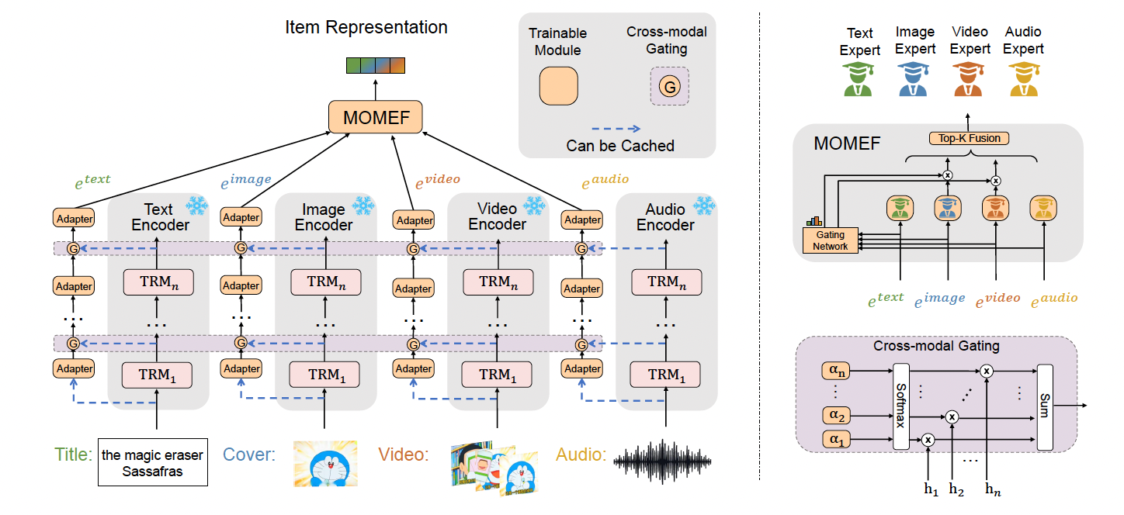
CROSSAN: Breadth Perspective (Preprint)
CROSSAN address this problem by a simple but effective cross-modal gating and mixture of modality expert fusion (MOMEF).

Slide 17
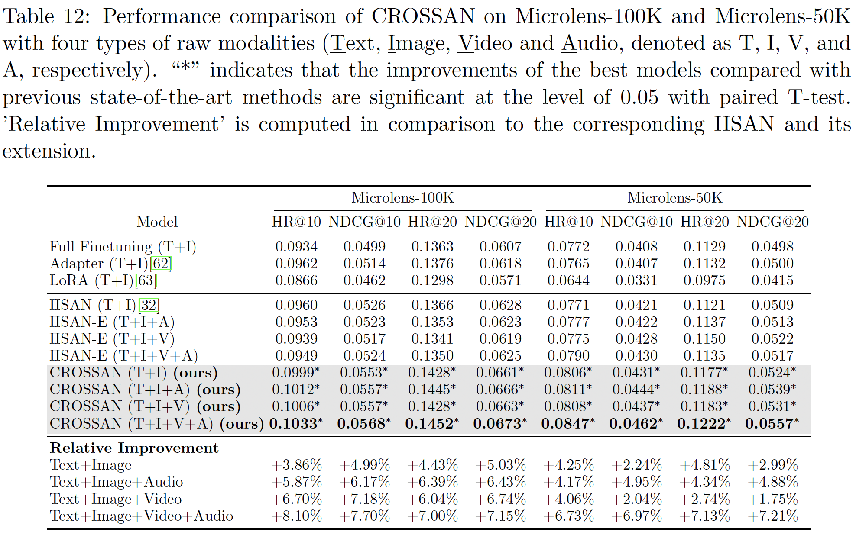
CROSSAN: Breadth Perspective (Preprint)
More modalities
Better Performance

Slide 18
Key Conclusions and Takeaways:
IISAN established the foundational work for efficient adaptation of foundation models in the recommendation domain, making the adaptation process highly efficient.
IISAN-Versa deepened the model architecture, enhancing its capacity and representation capability.
CROSSAN broadened the scope of IISAN by enabling adaptation across multiple modalities, extending its versatility and applicability.

Slide 19

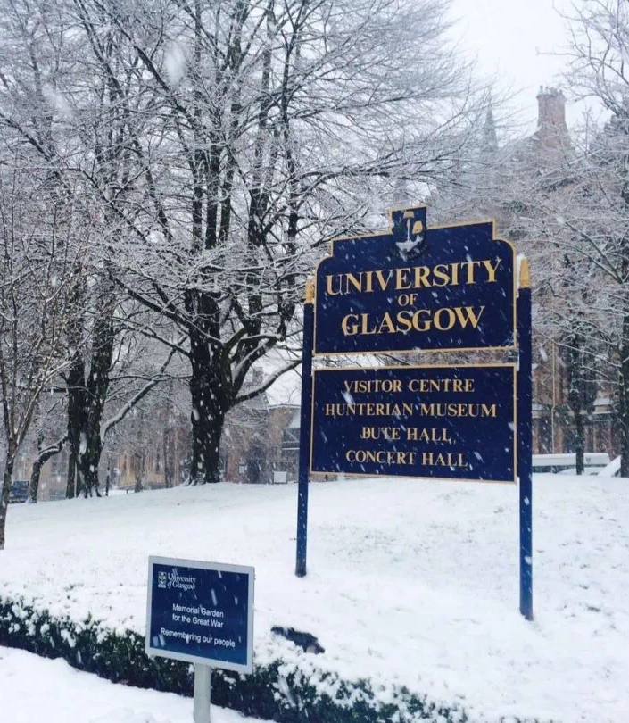

Thanks for your attention!
Q&A
Contact Email: j.fu.3@research.gla.ac.uk
Github:

